Slide 1
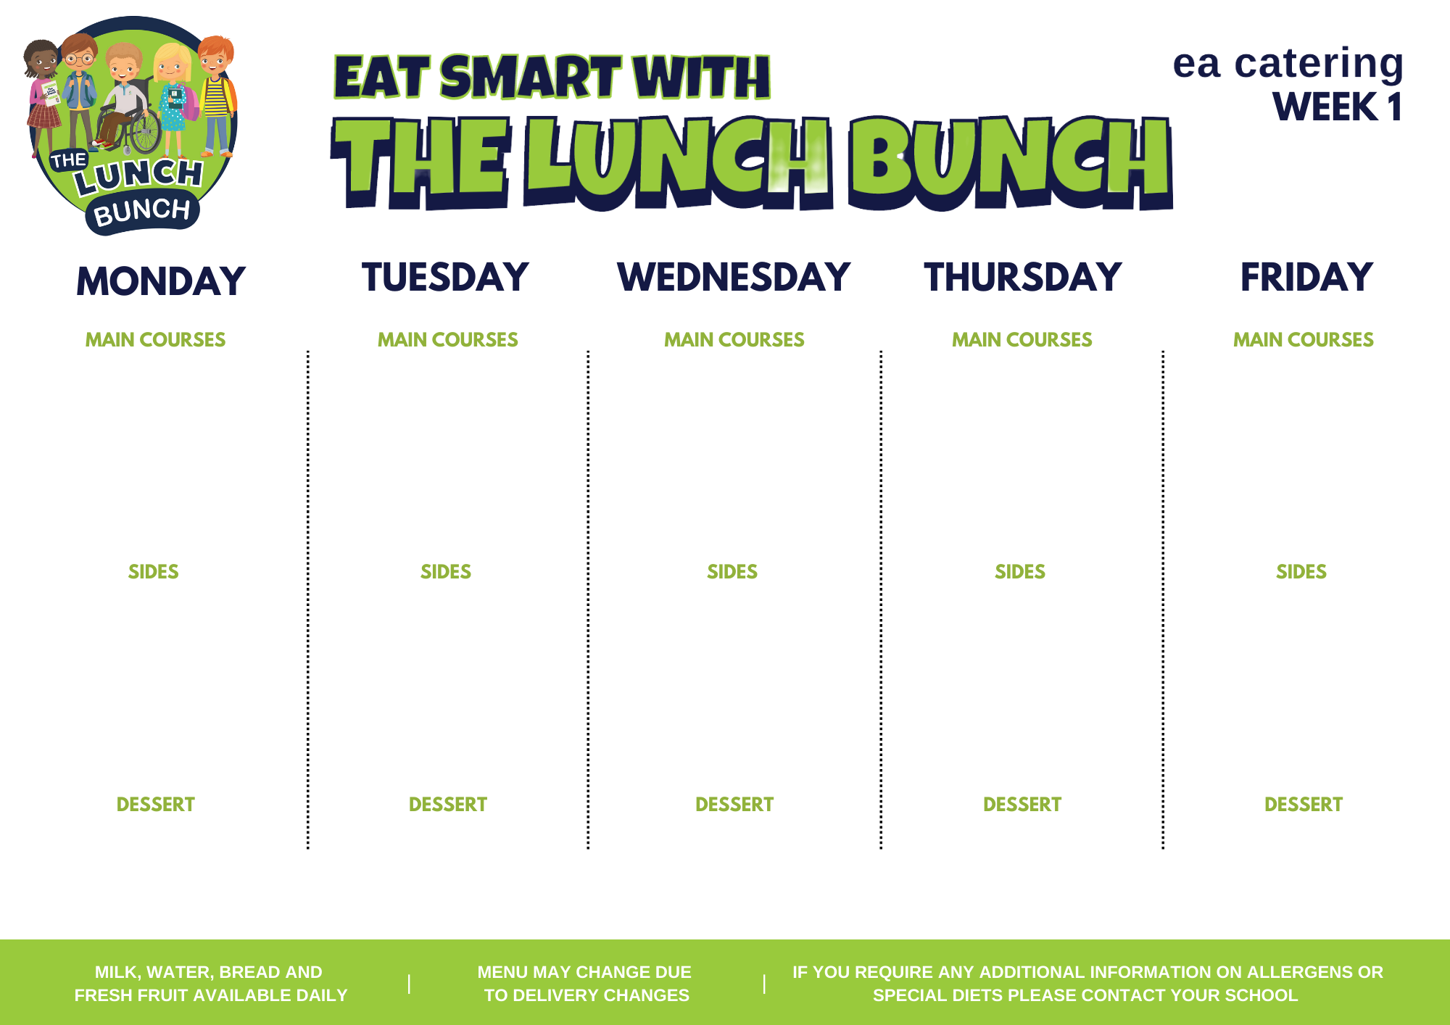
WEEK COMMENCING:
Jan 22, FEB 19,
MAR 18, APR 15,
MAY 13, JUN 10
Savoury Mince, Batton Carrots & Mash Potatoes
Or
Chicken & Ham Pasta Bake, Garlic Bread & Peas
Classic Margherita
Pizza, Chipped Potatoes & Salad
Or
Fish Fingers, Mash & Baked Beans
Roast Chicken Stuffing & Gravy
Lunch Bunch Chicken Curry, Naan Bread, Steamed Rice & Peas
Or
Chicken & Cheese Panini, Oven Baked Wedges
Hot Dog & Chipped Potatoes
Or
Crispy Cod Fishcakes & Baked Potato
Carrots & Broccoli
Mashed Potatoes/Oven Roast Potato
Sweetcorn
Tomato Ketchup
Toffee or Strawberry Yoghurt & Fresh fruit
Artic Roll & Fresh Fruit
Chocolate Brownie & Custard
Jelly & Fresh fruit
Fresh Fruit & Ice cream

Slide 2
WEEK COMMENCING:
29 JAN, FEB 26, MAR 25, APR 22, MAY 20, JUN 17
Sausage Roll, Chipped Potatoes & Spaghetti Hoops
Or
Sweet and Sour Chicken, Rice & Garden Peas
Pasta Bolognaise with Garlic Bread
Or
Pepperoni Pizza & Oven Roasted Potato Wedges
Roast Gammon with Stuffing & Gravy
Lunch Bunch Chicken Curry, Naan Bread & Steamed Rice
Or
Fish Fingers & Diced Potatoes
Beef Burger in a Bap with Tomato Ketchup, Chipped Potatoes & Sweetcorn
Or
Pepper Chicken, Rice & Salad
Sweetcorn
Cauliflower or Broccoli
Mashed Potatoes/Oven Roasted Potato
Garden Peas
Artic Roll & Fruit
Rice Krispie Sprinkle Cake
Blueberry
Muffin
Ice cream & Fruit
Yoghurt
& Fruit

Slide 3
WEEK COMMENCING:
JAN 08, FEB 05,
MAR 04, APR 01,
APR 29, MAY 27,
JUN 24
Golden Crumbed Fish Fingers, Chipped Potatoes & Baked Beans
Or
Mighty Mac ‘n’ Cheese with Garlic Bread Slice
Lunch Bunch Chicken Curry, Naan Bread & Steamed Rice
Or
Steak Burger in a Bap & Cheese with Salad
Tasty Pork Sausages with Tomato Ketchup/Gravy & Spaghetti Hoops
Or
Salt N Chili Chicken Wrap with Garlic Mayo & Mini Corn on the cob
Chicken Goujons
Or
Margherita Pizza
Roast Chicken Stuffing & Gravy
Garden Peas
Diced Potatoes
Carrot /Cauliflower Cheese
Mashed Potatoes/Oven Roast Potato
Chipped Potatoes
Artic Roll & fruit
Fresh Fruit Pot
Old School Cake & Custard
Jelly & Fruit
Ice cream & fruit

Slide 4
WEEK COMMENCING:
JAN 15, FEB 12,
MAR 11, APR 08, MAY 06, JUN 03
Pasta Bolognaise with Garlic Bread
Or
Cod Fishcakes & Oven Baked Wedges
Pepperoni Pizza & Chipped Potatoes
Or
Chicken & Broccoli Pasta Bake & Garlic bread
Roast Gammon Stuffing & Gravy
Lunch Bunch Chicken Curry, Naan Bread & Steamed Rice
Or
BBQ Chicken Wrap & Potato Wedges
Oven Baked Chicken Goujons & Baked Beans
Or
Sweet Chili Chicken Panini
Garden Peas
Sweetcorn
Broccoli/ Carrots
Mashed Potatoes/Oven Roast Potato
Peas
Chipped Potatoes
Yoghurt & fruit
Jelly & Fruit
Cornflake Tart & Custard
Shortbread & Milkshake
Ice cream m & fruit

