Slide 2
The New Seven Wonders of the World
The ancient world had seven significant places, known as ‘The Seven Wonders of the World’. In 2000, a campaign began to choose seven wonders of the modern world.
Over 100 million votes were cast. The final seven places chosen were:
Chichén Itzá, Mexico;
Machu Picchu, Peru;
Christ the Redeemer, Brazil;
The Colosseum, Italy;
Petra, Jordan;
Taj Mahal, India;
The Great Wall, China.
Today, we are going to find out about the Colosseum in Italy.

Slide 3
Where Is Italy?
Italy

Slide 4
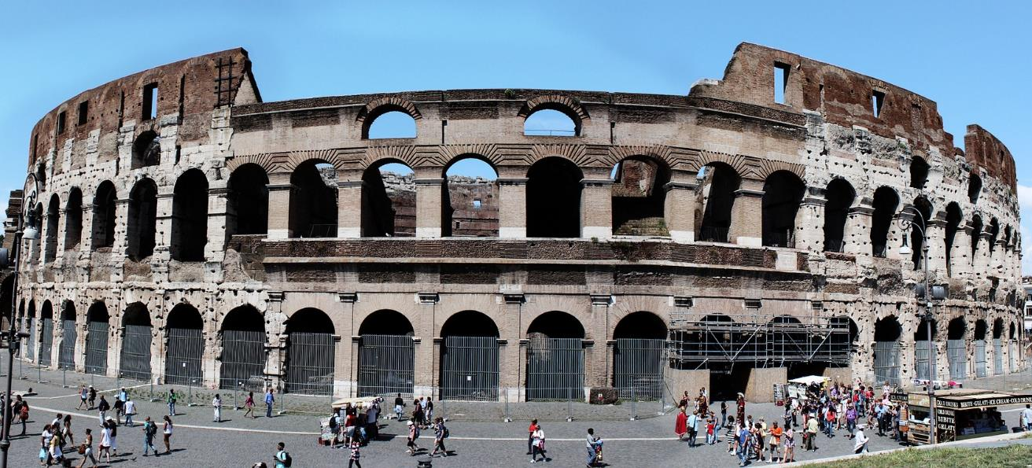
The Colosseum
The Colosseum is about 156 metres wide and 50 metres high - that’s about the same height as a 12 storey building.

Slide 5
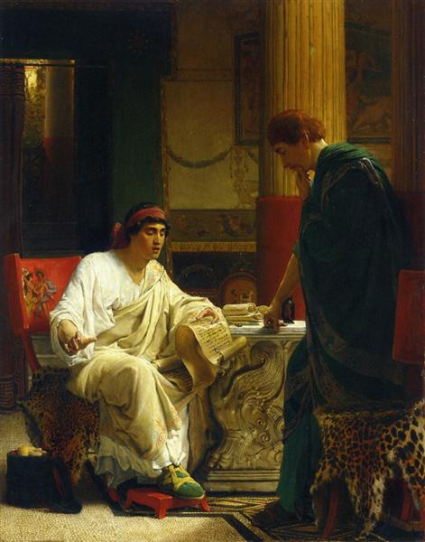
The Flavian Amphitheatre
Vespasian ruled the Roman Empire from AD 69 – 79. During this time, he ordered a huge amphitheatre to be built. In AD 68, an unpopular emperor called Nero died. The amphitheatre was a symbolic gift to the Roman people, who had all suffered under Nero’s rule.
The amphitheatre was completed in AD 80 and was designed to be used for entertainment. It was to be used to showcase gladiator fights, exhibits of exotic animals, the executions of prisoners and recreations of famous Roman battles.
Vespasian hearing from one of his generals

Slide 6
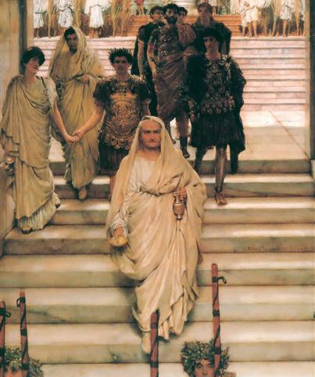
Building the Amphitheatre
Opened in AD 80 by Titus, Vespasian's son, it was initially called the Flavian Amphitheatre because Vespasian was from the Flavian family of emperors in Rome. However, it was built on the ruined palace of Nero, which displayed a huge statue of the fallen emperor, known as ‘The Colossus of Nero’. The name of the amphitheatre gradually changed to the Colosseum as the statue became associated with the amphitheatre.
Construction of the Colosseum took almost a decade, which was very quick for such a huge structure. It was mostly built by enslaved people.
The Triumph of Titus

Slide 7
The Colosseum
The Colosseum was enormous, even by other Roman buildings’ standards. Made from stone and concrete, it was the largest freestanding structure in the Roman Empire. Other amphitheatres were built into hillsides so that they were supported.
The structure was 188m long, 156m wide and 50m high. It was composed of three storeys: terraces; a facade separate from the terraces and a central arena. 80 arched entrances were created, which made it easier for spectators to access the building. When full, there could be more than
50,000 people seated according to their rank and status, ready for the entertainment to begin.
Canvas awnings would unfurl at the top of the amphitheatre to protect the crowds from the heat of the sun. Archaeologists believe that it also had drinking fountains and toilets.

Slide 8
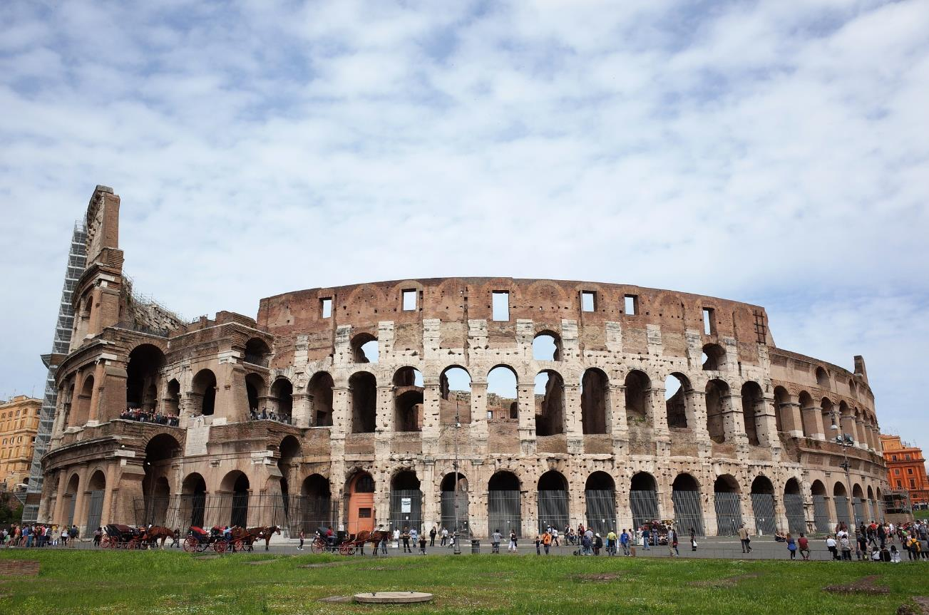
Outside the Colosseum

Slide 9
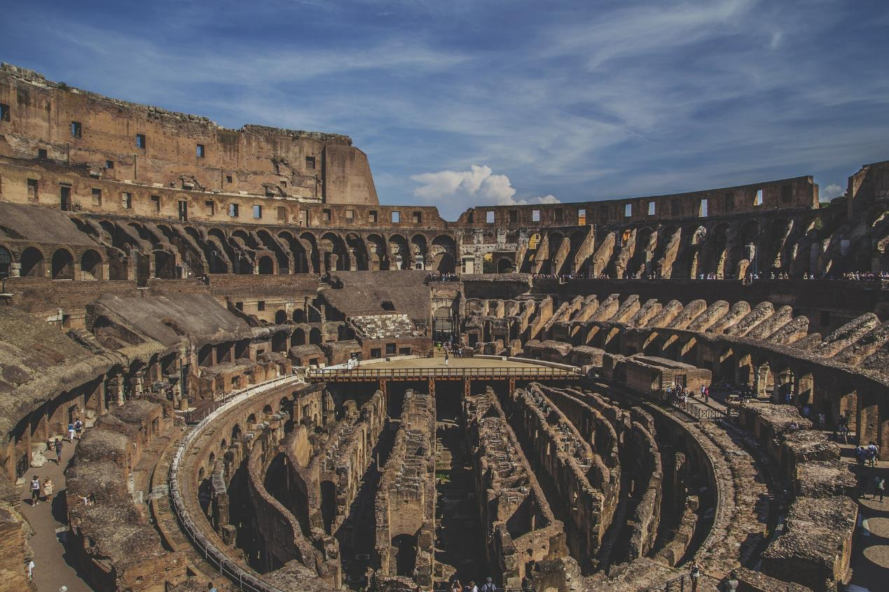
Inside the Colosseum

Slide 10
The Inaugural Games
Titus, Vespasian’s son, became the Emperor of Rome in AD 79, after the death of his father.
In AD 80, Titus opened the amphitheatre with the inaugural games.
The games lasted for more than 100 days.

Slide 11
Gladiators
Gladiator fights were considered a sport. Gladiators were highly trained and even had medical checks before training began. Contenders were matched based on their experience, skill, age, size and style of fighting. They were prisoners, enslaved people, criminals and ex-soldiers, who could gain celebrity status and wealth if they were good at what they did and became well-known.
Before a match, gladiators would be held below the arena in the dark, cool rooms and tunnels. Then, they would make their dramatic entrance.
They had to show courage and absolutely no fear.

Slide 12
Animals
Gladiators were not the only living things who fought in the name of entertainment.
Animals from around the world thought to be exotic and unusual were brought to the colosseum and made to fight people. These included lions, hippopotamuses, crocodiles, elephants, leopards, bears, tigers and boars. Wolves were not used, as they had symbolic importance for Romans at that time.
Sometimes, the animals killed the people who were supposed to kill them.

Slide 13
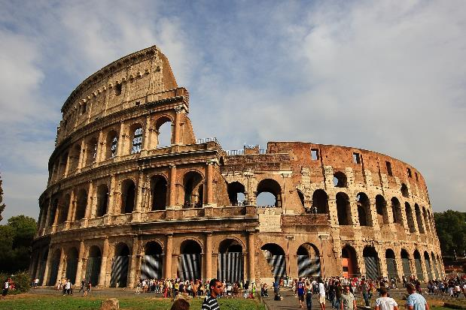
The Colosseum Today
The Colosseum has seen many changes since it was built nearly 2000 years ago. Two thirds of it has been destroyed through earthquakes, lightning strikes and bombings during the Second World War.
Over time, it has been used as a storehouse, a church, a cemetery and even a castle.
In 2007, it was included in the list of the new Seven Wonders of the World.
It remains as a symbol of the power and rule of the Roman Empire and draws over 7 million visitors a year, who want to learn about this amazing structure and its colourful history.

