Slide 2
The Ancient Seven Wonders of the World
The ancient Seven Wonders of the World is a list of remarkable, humanly-constructed landmarks from ancient, classical civilisations. The original list dates from the second century BC. The landmarks consist of a pyramid, a mausoleum, a temple, two statues, a lighthouse and a garden.
The ancient Seven Wonders of the World are:
•The Lighthouse of Alexandria
•The Colossus of Rhodes
•The Statue of Zeus at Olympia
•The Temple of Artemis at Ephesus
•The Hanging Gardens of Babylon
•The Great Pyramid of Giza
•The Mausoleum at Halicarnassus

Slide 3
The Ancient Seven Wonders of the World
Why was the list created?
When early Greek travellers began to travel and explore other ancient civilisations, such as the Egyptians, Persians and Babylonians, they were impressed with some of the marvellous and imaginative architecture they saw. They began to put together lists of some ‘must-see’ recommendations for future visitors.
They called these inspiring landmarks ‘theamata’ - meaning ‘sights’. Over time, this developed into the more magnificent name ‘thaumato’
- meaning ‘wonders’.
Therefore, the ancient Seven
Wonders of the World was an
early tourist guidebook!

Slide 4
The Ancient Seven Wonders of the World
Even though there are a multitude of hugely impressive ancient sights, there have only ever been seven ancient Wonders of the World.
The ancient Greeks believed the number seven represented perfection so it was a particularly significant number for them.
Why are there only seven?
The original list of the ancient Seven Wonders of the World has inspired a host of similar lists throughout history.
In 2000, a modern list of the new Seven Wonders of the World was created, consisting of landmarks that are still in existence today.

Slide 5
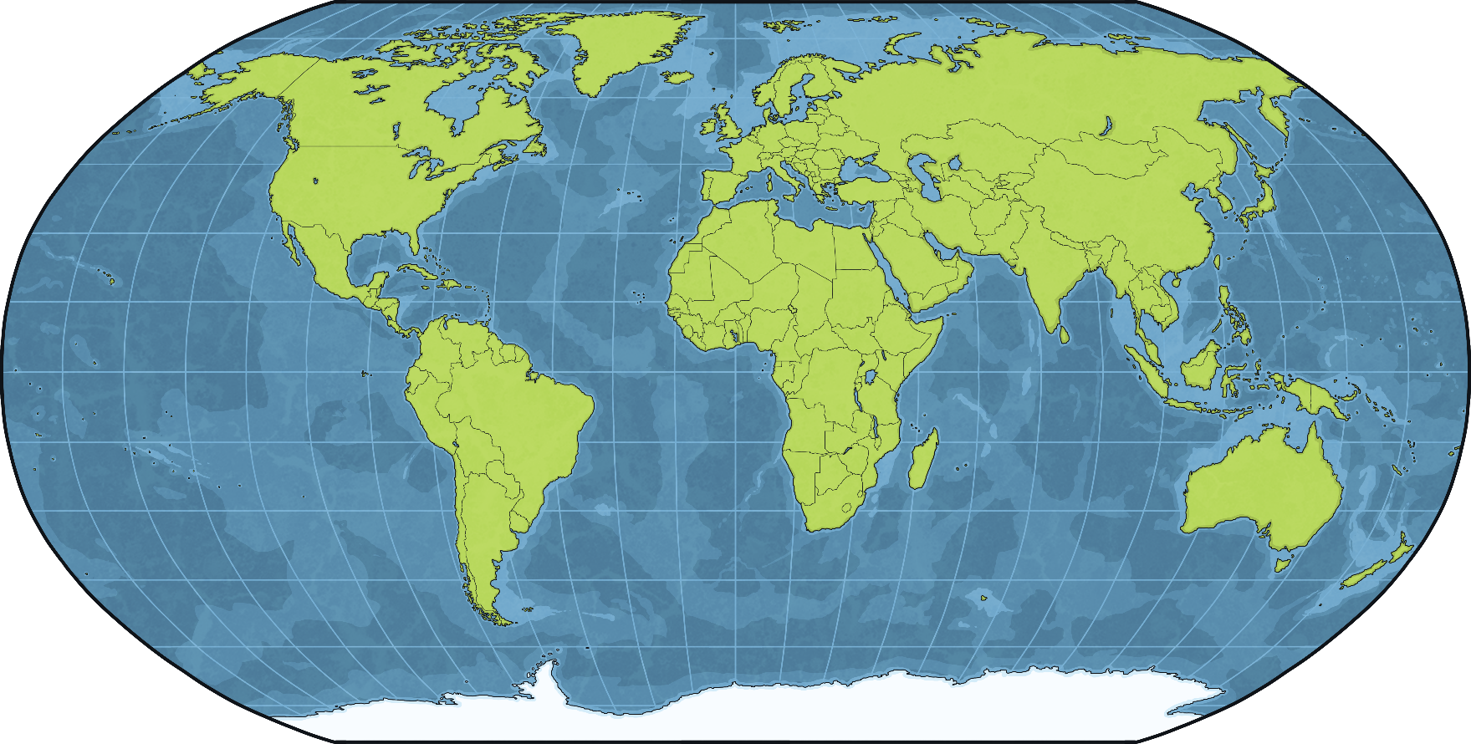
The Colossus of Rhodes
The Colossus of Rhodes was one of the ancient Seven Wonders of the World. It was on the island of Rhodes in Greece.
Greece
Rhodes

Slide 6
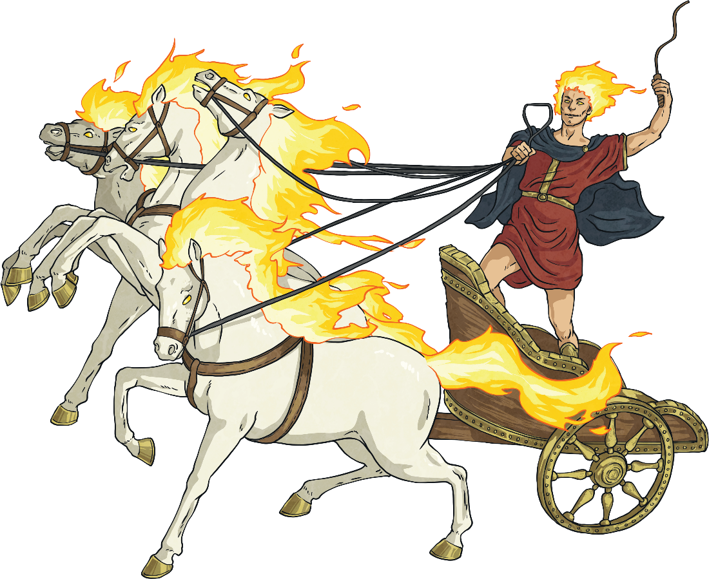
Helios
Helios was the ancient Greek god of the sun. The ancient Greeks believed that Helios travelled in a four-horse chariot and pulled the sun across the sky each day. A famous ancient Greek poem described him in the following way:
"...he shines upon men and deathless gods, and piercingly he gazes with his eyes from his golden helmet. Bright rays beam dazzlingly from him, and his bright locks streaming from the temples of his head gracefully enclose his far-seen face: a rich, fine-spun garment glows upon his body and flutters in the wind: and stallions carry him…”

Slide 7
The Siege of Rhodes
Helios was the patron god of the island of Rhodes. In 305 BC, Demetrius, King of Macedon, attempted to seize control of the island because of its large navy and the fact that it controlled the entrance to the Aegean Sea.
For a year, Demetrius laid siege to the island. However, the citizens of Rhodes managed to stop him from capturing the area and after a year, Demetrius ended the siege and signed a peace treaty with Rhodes.
laid siege – This means to surround a place in order to force the inhabitants to surrender.

Slide 8
The Statue
After the siege ended, the citizens of Rhodes decided to celebrate their victory by building a statue dedicated to Helios.
A sculptor named Chares of Lyndus was chosen to create the statue. Much of Demetrius’ military equipment had been abandoned and left in Rhodes. This was sold in order to raise money for the statue, which (according to Roman author Pliny the Elder) cost 300 talents.
talents – This is a Greek unit of weight. In this case, talents would have referred to an amount of silver.

Slide 9
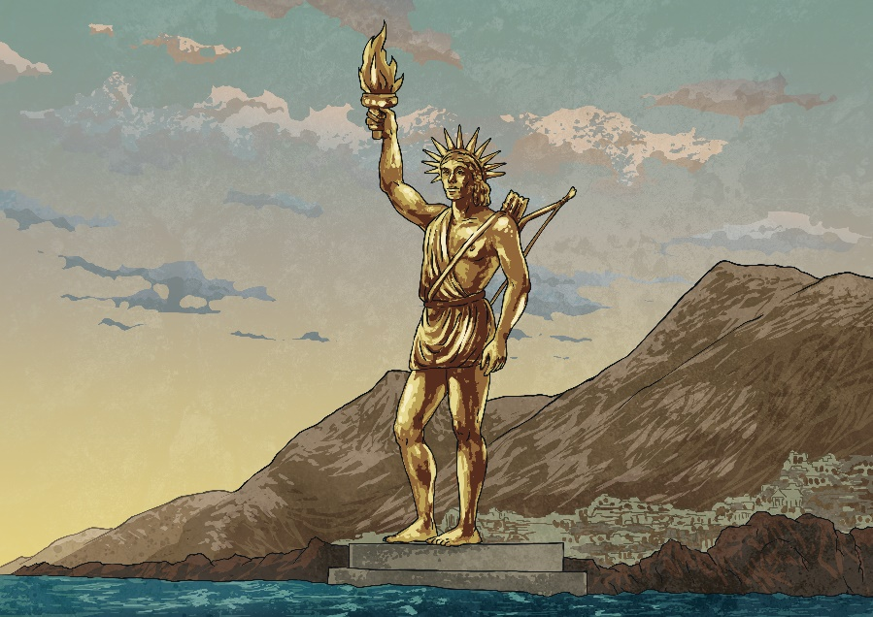
The Statue
The statue was built on-site. To reach the higher parts, it is likely a ramp of earth was built around the statue.
The statue was thought to have been over 30 metres tall – that’s about the same height as eight double-decker buses on top of each other!
The statue took 12 years to build.
Pliny the Elder said it was so big that ‘few men can clasp the thumb in their arms.’
It was made with an iron frame that was weighted with stone and then covered in a layer of bronze.
We aren’t exactly sure what the statue looked like, as there are no surviving detailed descriptions.

Slide 10
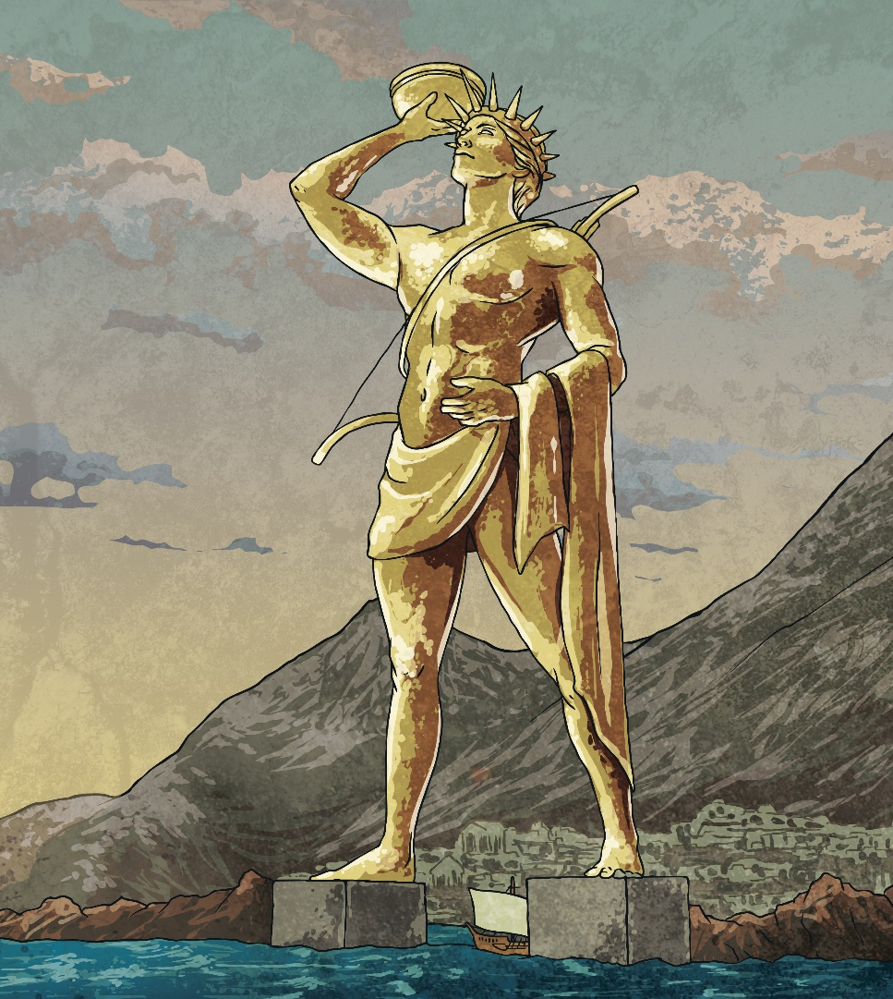
The Statue
The exact location of where the statue stood isn’t known. For centuries, it was believed that the Colossus stood at the entrance to Mandraki Harbour, with one leg either side of the harbour walls like in this picture.
However, it is now agreed that, given the height of the statue and the width of the harbour entrance, it would be impossible for the statue to be positioned in this way. It is now thought that the Colossus was positioned to the east of the harbour or possibly further inland.

Slide 11
The Statue
A dedication was written on the statue, which said, ‘To you, O Sun, the people of Dorian Rhodes set up this bronze statue reaching to Olympus when they had pacified the waves of war and crowned their city with the spoils taken from the enemy’.
Did You Know…?
The statue’s title of ‘Colossus’ does not refer to its size. At the time, colossus was actually a word used by the Greeks to refer to a special type of statue. Thanks to the size of the Colossus of Rhodes, the word became to mean extremely large.

Slide 12
The Destruction of the Statue
The statue only remained in place for just over 50 years. In either 226 or 225 BC, an earthquake devastated Rhodes. It is thought that the statue broke off at the knees and collapsed.
The remains of the Colossus stayed where they fell for hundreds of years and people continued to visit it. Upon seeing the fallen statue, Pliny the Elder said that out of all the large statues in the world, the Colossus of Rhodes was ‘by far the most worthy of our admiration’. He wrote that people were interested to visit the statue and look inside it to see how it had been put together.
A writer in the 2nd century AD joked that the Colossus of Rhodes was so big it could be seen from the Moon.

Slide 13
The Destruction of the Statue
Even though Ptolemy III of Egypt, who had an alliance with Rhodes, offered to pay for the statue to be rebuilt, it was never reconstructed. According to a Greek historian, this was because a fortune teller (known as an Oracle) told the citizens not to move it for fear of bad luck.
In AD 654, Rhodes was conquered by the Umayyad Empire. The statue was completely demolished. The stone was used in other buildings and the bronze was sold as scrap. It is said that more than 900 camels were needed to carry away all the parts of the Colossus.
Talk About It
If you were going to build a statue of someone, who would it be of and what would it look like?

Slide 14
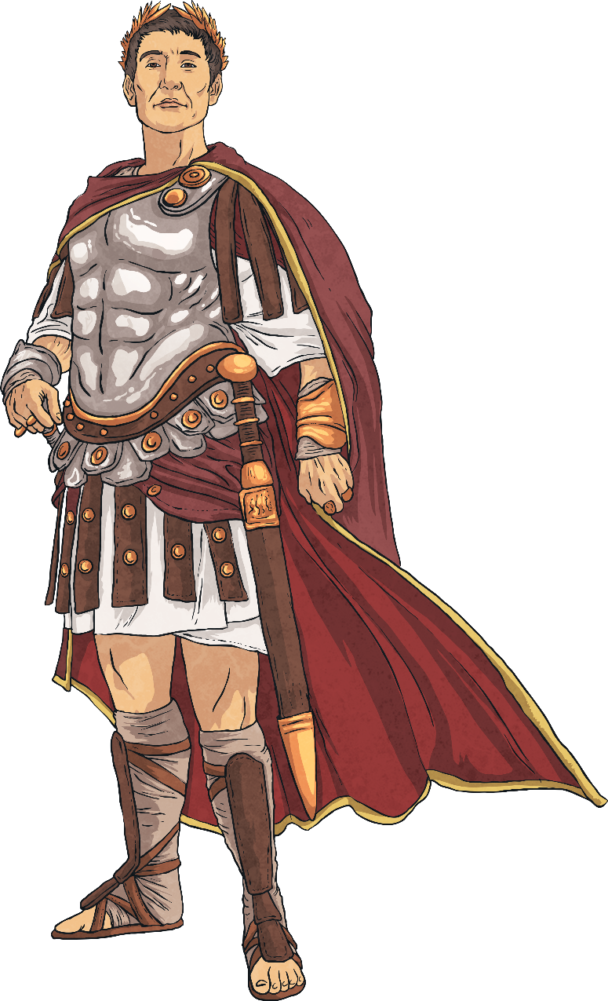
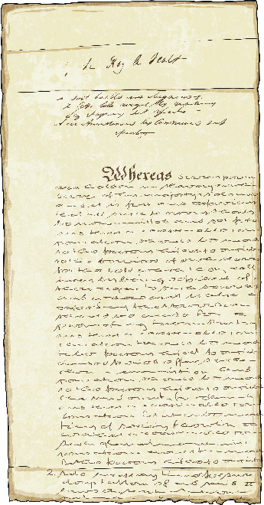
The Legacy of the Colossus
Even though we don’t know exactly what the Colossus of Rhodes looked like, its story has inspired people throughout history.
In William Shakespeare’s play, ‘Julius Caesar’, one of the characters says of Caesar, ‘he doth bestride the narrow world Like a Colossus, and we petty men Walk under his huge legs’.

Slide 15
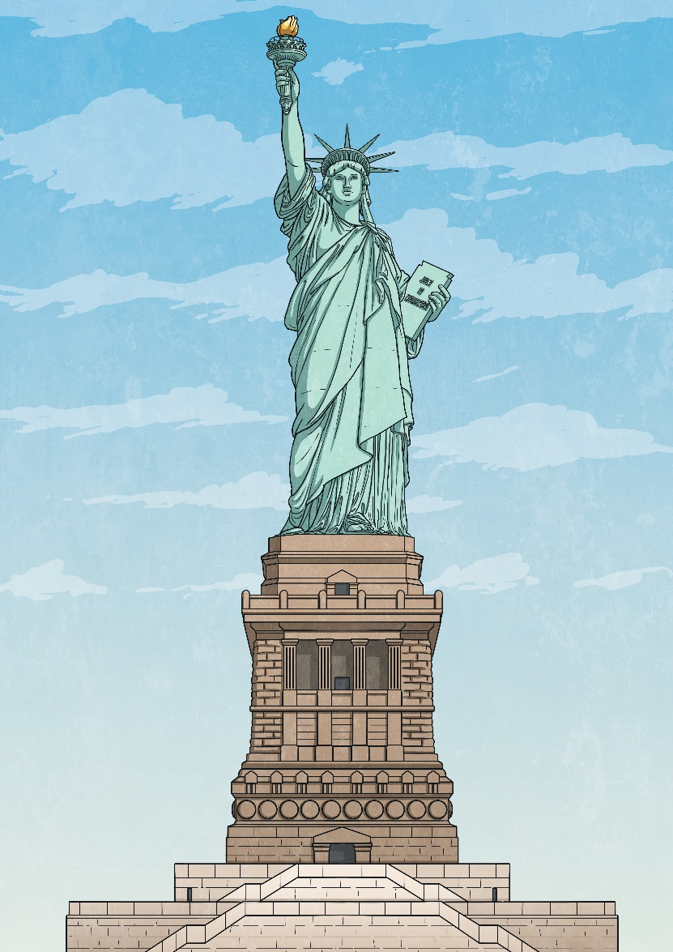
The Legacy of the Colossus
French sculptor Frédéric Auguste Bartholdi based his design for the Statue of Liberty on the stories of the Colossus of Rhodes. To raise money for the statue’s pedestal to be built, Emma Lazarus wrote a poem called ‘The New Colossus’. The poem is inscribed on the pedestal.

