Slide 2
The Ancient Seven Wonders of the World
The ancient Seven Wonders of the World is a list of remarkable, humanly-constructed landmarks from ancient, classical civilisations. The original list dates from the second century BC. The landmarks consist of a pyramid, a mausoleum, a temple, two statues, a lighthouse and a garden.
The ancient Seven Wonders of the World are:
•The Lighthouse of Alexandria
•The Colossus of Rhodes
•The Statue of Zeus at Olympia
•The Temple of Artemis at Ephesus
•The Hanging Gardens of Babylon
•The Great Pyramid of Giza
•The Mausoleum at Halicarnassus

Slide 3
The Ancient Seven Wonders of the World
Why was the list created?
When early Greek travellers began to travel and explore other ancient civilisations, such as the Egyptians, Persians and Babylonians, they were impressed with some of the marvellous and imaginative architecture they saw. They began to put together lists of some ‘must-see’ recommendations for future visitors.
They called these inspiring landmarks ‘theamata’ - meaning ‘sights’. Over time, this developed into the more magnificent name ‘thaumato’
- meaning ‘wonders’.
Therefore, the ancient Seven
Wonders of the World was an
early tourist guidebook!

Slide 4
The Ancient Seven Wonders of the World
Even though there are a multitude of hugely impressive ancient sights, there have only ever been seven ancient Wonders of the World.
The ancient Greeks believed the number seven represented perfection so it was a particularly significant number for them.
Why are there only seven?
The original list of the ancient Seven Wonders of the World has inspired a host of similar lists throughout history.
In 2000, a modern list of the new Seven Wonders of the World was created, consisting of landmarks that are still in existence today.

Slide 5
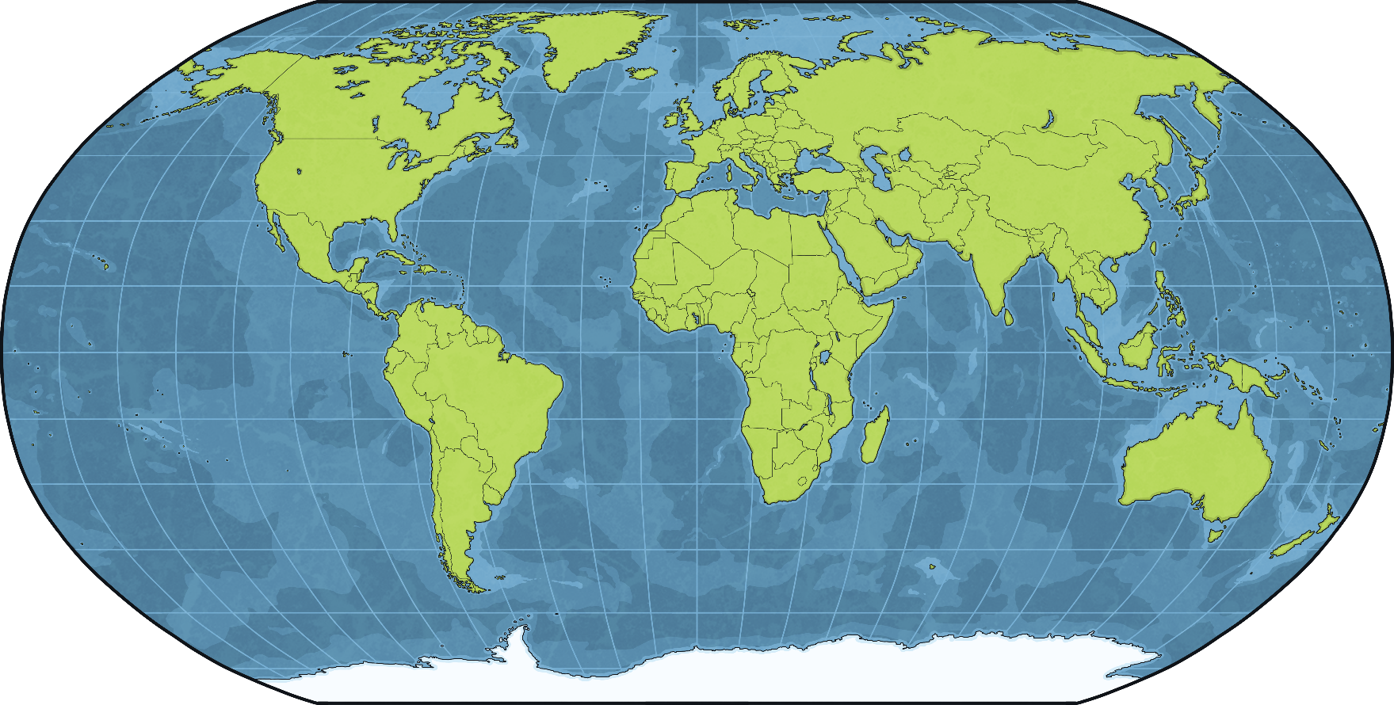
The Temple of Artemis
It was in a Greek city called Ephesus which was located in what is now modern-day Turkey.
Turkey

Slide 6
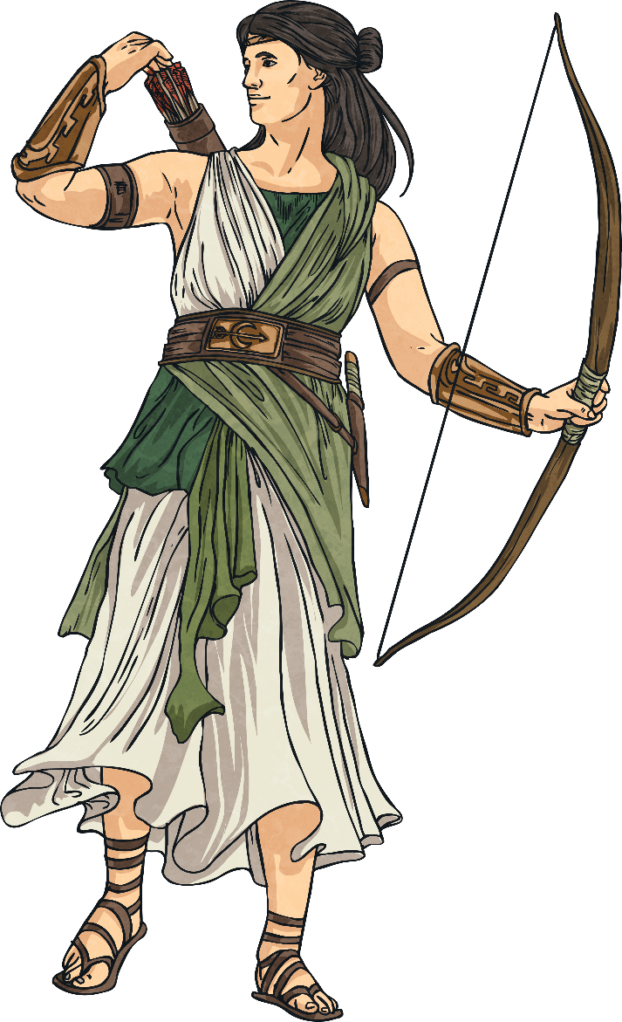
Who Was Artemis?
The ancient Greeks had a series of gods and goddesses who were believed to be responsible for different elements of life. The ancient Greeks believed that these gods and goddesses lived on Mount Olympus and were ruled over by Zeus.
According to Greek mythology, Artemis was the daughter of Zeus and a Greek goddess called Leto. She had a twin brother called Apollo, who was the sun god. Artemis was goddess of the Moon and the hunt. She was also associated with nature and childbirth.
The Romans had a similar system of gods and goddesses. Their equivalent of Artemis was called Diana.

Slide 7
Worship of Artemis
The version of the Temple of Artemis that was listed as an ancient wonder wasn’t actually the first one. Archaeologists have discovered ruins of an early temple dedicated to the worship of Artemis on the same site. This was believed to be destroyed by flooding.
It is said that the Ephesians (people who lived in Ephesus) had a special dedication to worshipping the goddess. Some sources say that they believed Ephesus to be the birthplace of Artemis.
A famous historian, called Herodotus, told a story that the Ephesians tied a rope from an early version of the temple to the walls of the city in order to protect them from invasions.
Talk About It
Like the Ephesians, people have many habits or superstitions they believe can protect them. One example is knocking on a piece of wood in order to stop something bad from happening. Can you think of any other examples? Why do you think people have these beliefs?

Slide 8
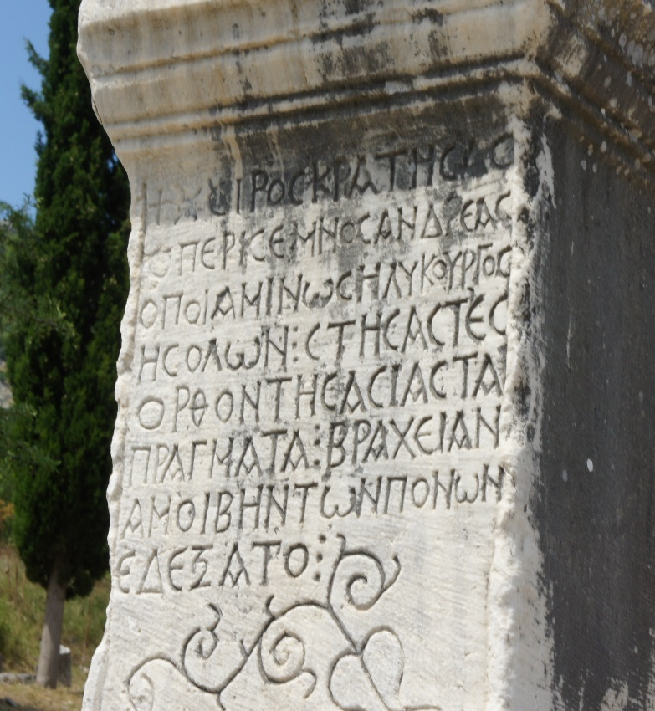
Ephesus
Between 560 and 550 BC, Ephesus was conquered by Croesus, king of a neighbouring place called Lydia. After he had conquered the city, Croesus used some of his great wealth to fund the building of structures all across Ephesus, including a new temple dedicated to the worship of Artemis.
“Ephesus” by [Paulo O] is licensed under CC BY 2.0
Did You Know…?
Croesus was so wealthy that, even today, the phrase ‘rich as Croesus’ is sometimes used to describe a very rich person.

Slide 9
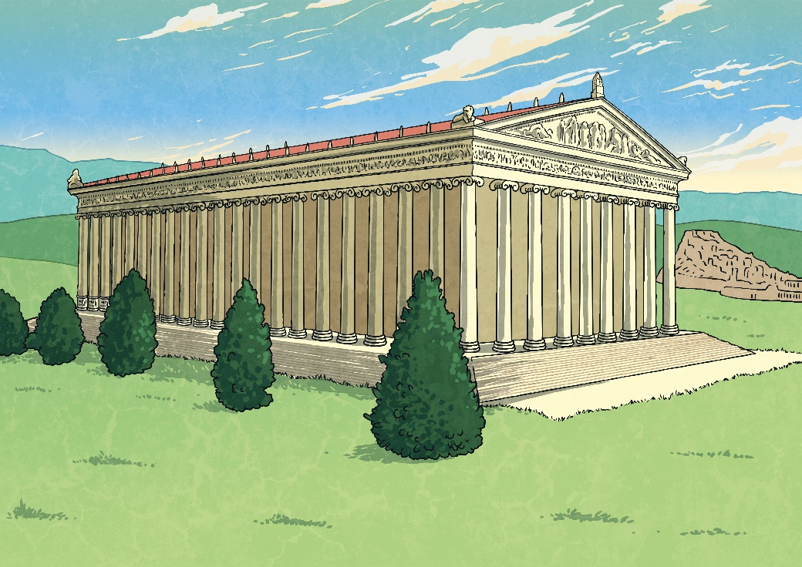
The Temple of Artemis
The temple, sometimes called the Artemisium, was about 110 metres long and 55 metres wide. It was believed to have taken 120 years to build and is thought to be the first Greek temple made completely of marble.
The outside was decorated with scenes from Greek mythology, including stories of the Amazons, warriors who came to Ephesus to seek safety from Heracles.
The temple had double rows of columns.
Did You Know…?
The Temple of Artemis was around twice the size of the Parthenon in Athens.

Slide 10
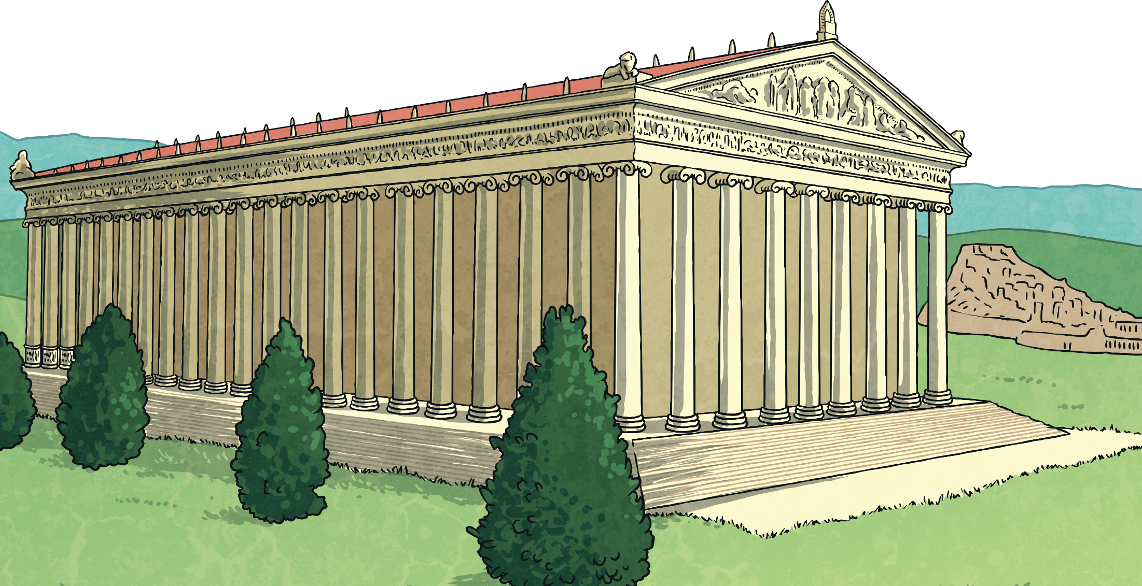
Destruction and Rebuilding
In 356 BC, this version of the temple was destroyed in a fire. The fire was started by a man called Herostratus. When he was captured, Herostratus said he started the fire deliberately in order to make his name known across the land.
In 323 BC, work to rebuild the temple began. Although Alexander the Great reportedly offered to pay for the new temple, the Ephesians declined and chose to fund it themselves. The design remained similar to the first temple and it is this temple that became a seventh wonder.

Slide 11
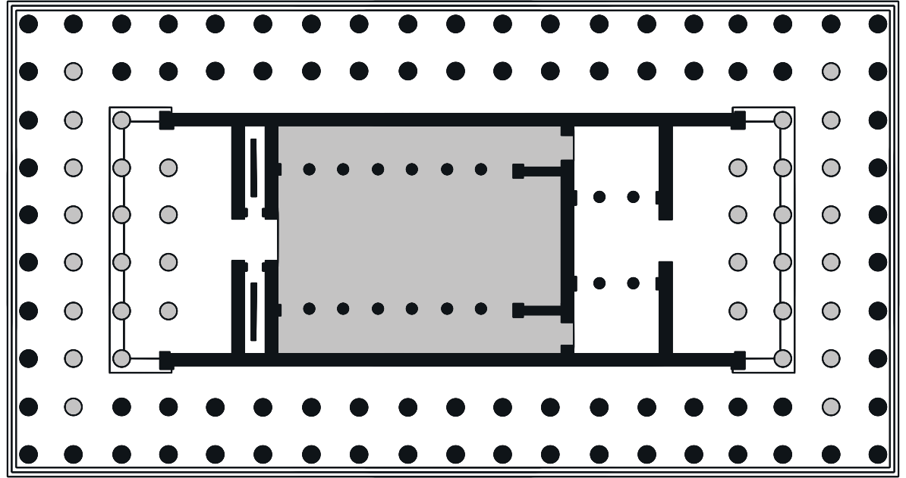
The Cella
Inside the temple was an inner building called the cella. A cella was a rectangular building found inside Greek or Roman temples that contained a large statue of the god or goddess to whom the temple was dedicated.
Although the original statue from the temple has long been destroyed, copies of it show it wearing clothing decorated with animals and a tall headdress. The original was believed to have been made of gold, silver, ebony and possibly black stone or wood.

Slide 12
The Temple of Artemis and the Bible
Around the time Christianity started to spread, the Temple of Artemis was still an important place and it is mentioned in the Bible. The story is told of a man named Demetrius who lived in Ephesus. Demetrius was a silversmith who made miniature silver shrines of Artemis for people who had visited the temple to take home to continue their worship of the goddess.
Later on in the account, the mayor of the city says, ‘Everyone knows that Ephesus is the official guardian of the temple of the great Artemis, whose image fell down to us from heaven.’

Slide 13
The End of the Temple
It is thought that the temple was badly damaged in a raid by a tribe called the Goths in AD 262. Through their attacks on areas throughout Europe and into Asia, the Goths played a major part in the fall of the Roman Empire.
The spread of Christianity also contributed to the end of the temple. In AD 391, Theodosius I outlawed the practice of paganism, which included the worship of Artemis. Temples to Greek and Roman gods and goddesses were closed down and it is thought the Temple of Artemis was totally destroyed.
Did You Know…?
Many people who saw all the ancient Seven Wonders of the World said that the Temple of Artemis was the most beautiful of them all.

Slide 14
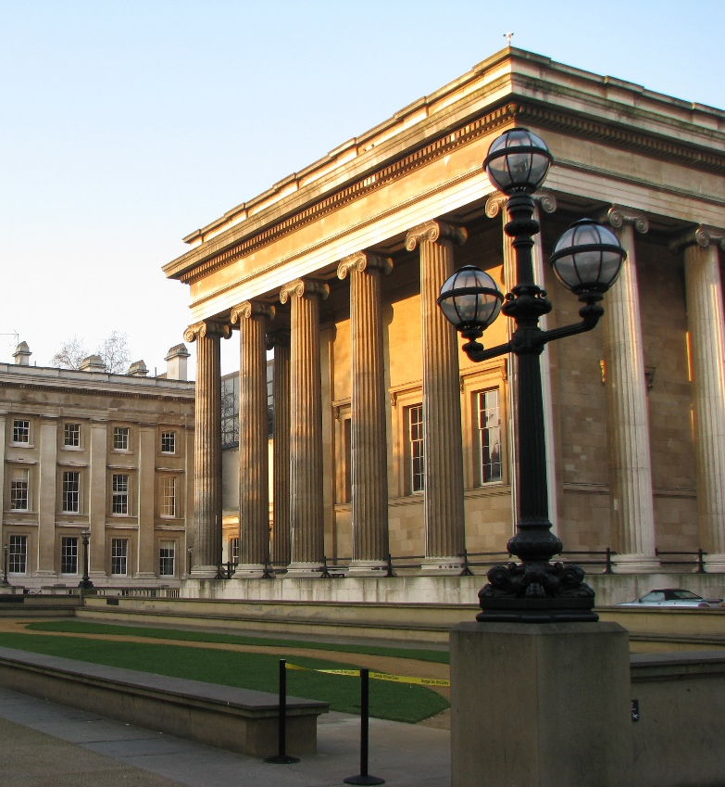
The Ruins of the Temple
In the 19th century, archaeologists began to carry out excavations on the site of the temple. Artefacts made of gold and silver dating back to the 7th century BC were discovered throughout the site. Pieces of columns from the last version of the temple were also found, which helped archaeologist understand the size of the original temple.
Many of the artefacts from the Temple of Artemis are now on display in the British Museum in London.
British Museum in London
“The British Museum (3)” by [José María Mateos] is licensed under CC BY 2.0
Find Out About It!
The Temple of Artemis is just one of many key historical sites whose artefacts are now in the British Museum. Can you find out about some of the other sites?

Slide 15
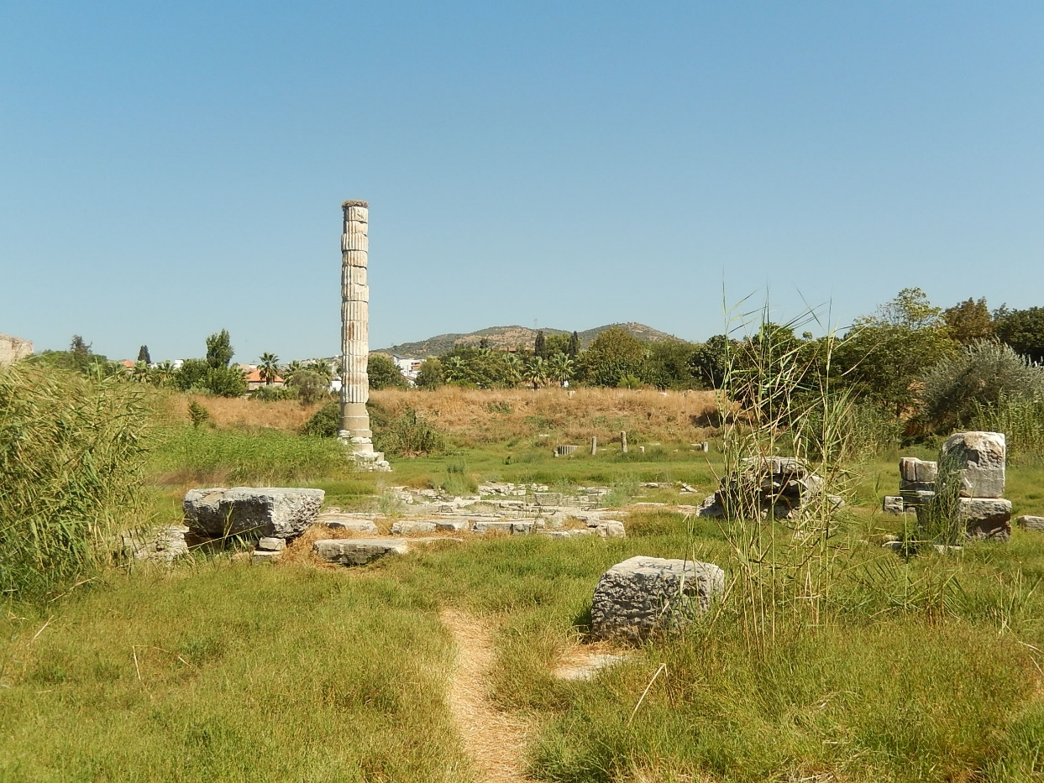
The Ruins of the Temple
All that remains on the site of the temple today are ruins, including a single column that was built using parts of columns from across the site.
“Temple of Artemis” by [Milena] is licensed under CC BY 2.0

