Slide 2
The Ancient Seven Wonders of the World
The ancient Seven Wonders of the World is a list of remarkable, humanly-constructed landmarks from ancient, classical civilisations. The original list dates from the second century BC. The landmarks consist of a pyramid, a mausoleum, a temple, two statues, a lighthouse and a garden.
The ancient Seven Wonders of the World are:
•The Lighthouse of Alexandria
•The Colossus of Rhodes
•The Statue of Zeus at Olympia
•The Temple of Artemis at Ephesus
•The Hanging Gardens of Babylon
•The Great Pyramid of Giza
•The Mausoleum at Halicarnassus

Slide 3
The Ancient Seven Wonders of the World
Why was the list created?
When early Greek travellers began to travel and explore other ancient civilisations, such as the Egyptians, Persians and Babylonians, they were impressed with some of the marvellous and imaginative architecture they saw. They began to put together lists of some ‘must-see’ recommendations for future visitors.
They called these inspiring landmarks ‘theamata’ - meaning ‘sights’. Over time, this developed into the more magnificent name ‘thaumato’ - meaning ‘wonders’.
Therefore, the ancient Seven Wonders of the World was an early tourist guidebook!

Slide 4
The Ancient Seven Wonders of the World
Even though there are a multitude of hugely impressive ancient sights, there have only ever been seven ancient Wonders of the World.
The ancient Greeks believed the number seven represented perfection so it was a particularly significant number for them.
Why are there only seven?
The original list of the ancient Seven Wonders of the World has inspired a host of similar lists throughout history.
In 2000, a modern list of the new Seven Wonders of the World was created, consisting of landmarks that are still in existence today.

Slide 5
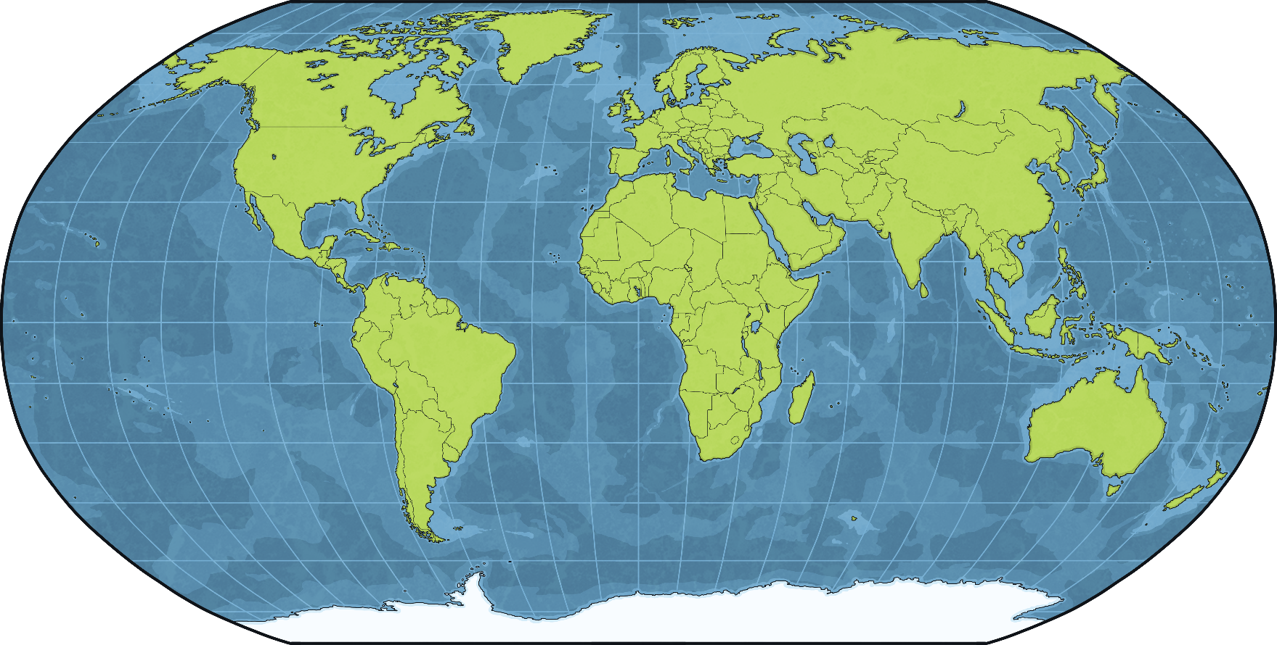
The Lighthouse of Alexandria
The Lighthouse of Alexandria was in the city of Alexandria in Egypt.
Egypt

Slide 6
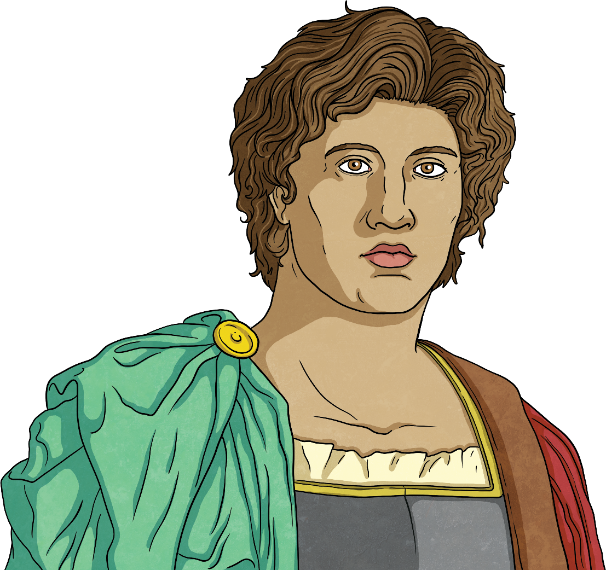
The City of Alexandria
The city was founded by Alexander the Great, King of the ancient Greek kingdom of Macedon, in 331 BC.
Alexander was born in Macedonia in 356 BC.
When Alexander was 20 years old, his father, King Philip II, was killed. Alexander took control of his empire and army.
Alexander wanted an even larger empire and he led his army to many victories, conquering countries and founding cities. He named many of the cities Alexandria after himself.
Alexandria in Egypt still exists today and is the country’s second largest city.

Slide 7
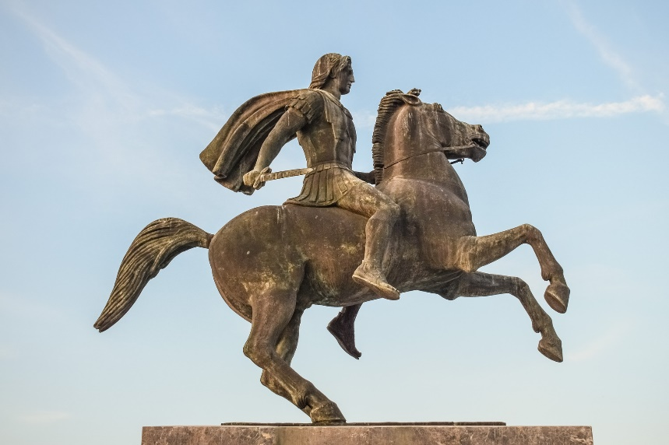
What Was Alexandria Like?
Alexandria had two harbours on the Nile delta and because of this, was an important trading area.
The city was carefully designed by Alexander’s chief architect, Dinocrates. A royal palace was built, as well as temples dedicated to Greek and Egyptian gods. There was a 1260 metre-long bridge that went from the city to the nearby island of Pharos. Canals dug from the Nile provided houses with fresh water.
Alexandria had a museum, where scholars from all over the world would come to learn. The museum’s library was the most famous in the world at the time.

Slide 8
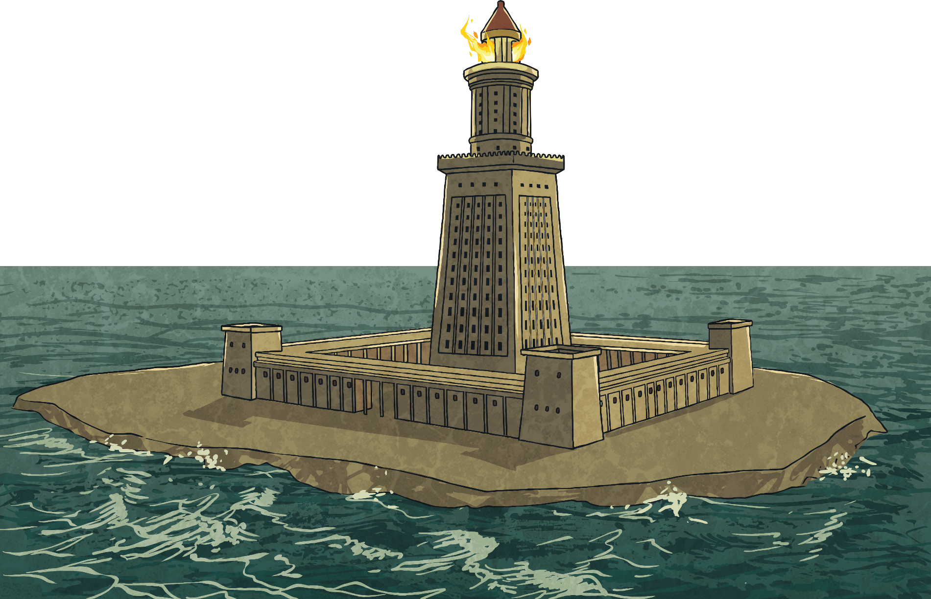
The Lighthouse
One of Alexandria’s most famous sites was its lighthouse. It was commissioned after the death of Alexander by Ptolemy I, who had declared himself King of Alexandria.

Slide 9
The Lighthouse
The lighthouse was situated on the island of Pharos, which was accessed from Alexandria by a bridge.
It was built using either blocks of limestone or of granite. The lighthouse is thought to have been around 110 metres high, with the square base being 30 metres wide.
Because the lighthouse was built to guide sailors safely into Alexandria, it was dedicated to two gods, Zeus Soter (god of safety and deliverance) and Proteus (sometimes known as ‘The Old Man of the Sea’).
It is believed the lighthouse took 15 years to complete.
Did You Know…?
At the time, the Lighthouse of Alexandria was the second tallest structure in the world, behind another wonder of the world, the Great Pyramid of Giza.

Slide 10
The Lighthouse
The light at the top of the tower was a furnace. Some historians believe that a large mirrored surface was used to reflect the sun’s light during the day.
The middle section of the tower was an octagonal structure. This shape would be used to build many lighthouse in later times.
The lower section was rectangular and had a ramp which enabled people and goods to travel further up the lighthouse.

Slide 11
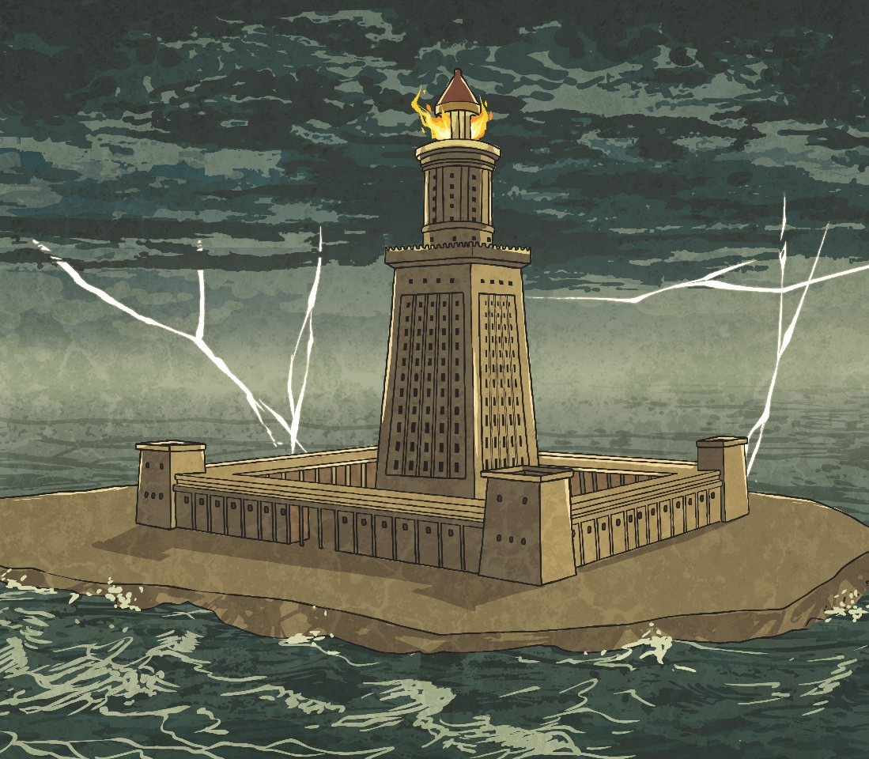
The Destruction of the Tower
Over time, the lighthouse suffered damages from several powerful earthquakes, particularly in the years 796, 950, 1303 and 1323. At times, repairs and additions were made. However, the last historical account of the lighthouse is from the 14th century, which suggests it was completely destroyed around this time. By the 15th century, its foundations had been used to build a fort.
Did You Know…?
The word ‘pharos’ (the island the lighthouse was on) is often used to describe towers.

Slide 12
UNESCO
In the early 20th century, divers began to study the remains around the harbour of Alexandria. Coins, possibly from the time of Ptolemy I, and stones that could have been from the lighthouse were discovered. In the 1960s, UNESCO (United Nations Educational, Scientific and Cultural Organisation) sponsored an expedition to explore the harbour, where more remains of the lighthouse and other buildings were discovered.
A proposal has now been made that the harbour area of Alexandria is declared an underwater museum.
Did You Know…?
The Lighthouse of Alexandria was the third to last wonder of the ancient world to survive, behind the Great Pyramid of Giza and the Mausoleum at Halicarnassus. Today, only the Great Pyramid survives.

