Slide 2
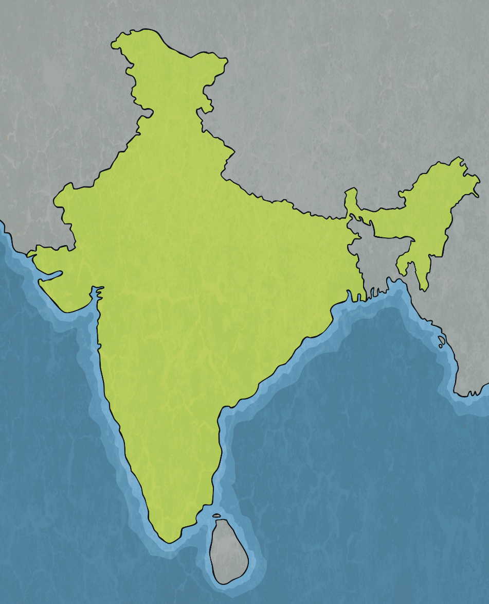
Exploring the Taj Mahal
The Taj Mahal is an extravagant tomb complex built in 1632.
It is located on the south bank of the Yamuna River in Agra, India.
In 2007, the Taj Mahal was named one of the seven wonders of the modern world.
Taj Mahal
India

Slide 3
Exploring the Taj Mahal
The Taj Mahal was commissioned by Mughal Emperor Shah Jahan to house the remains of his favourite wife Mumtaz Mahal. Mumtaz died while giving birth to the couple’s 14th child and Shah was so heartbroken he immediately began planning the most elaborate tomb he could make for her.

Slide 4
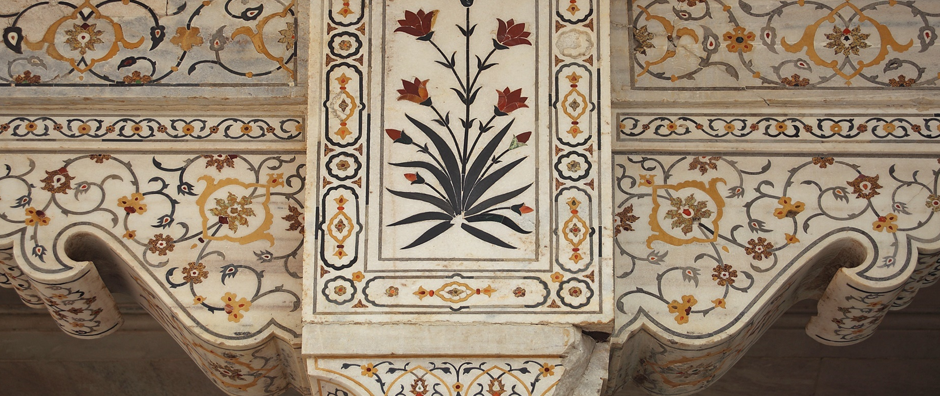
The Central Building
The central building is made of white marble mined from Northern India and inlaid with 28 types of precious and semi precious jewels, such as jade from China, lapis lazuli from Afghanistan and sapphire from Sri Lanka. These glimmer when you shine a torch against them.

Slide 5
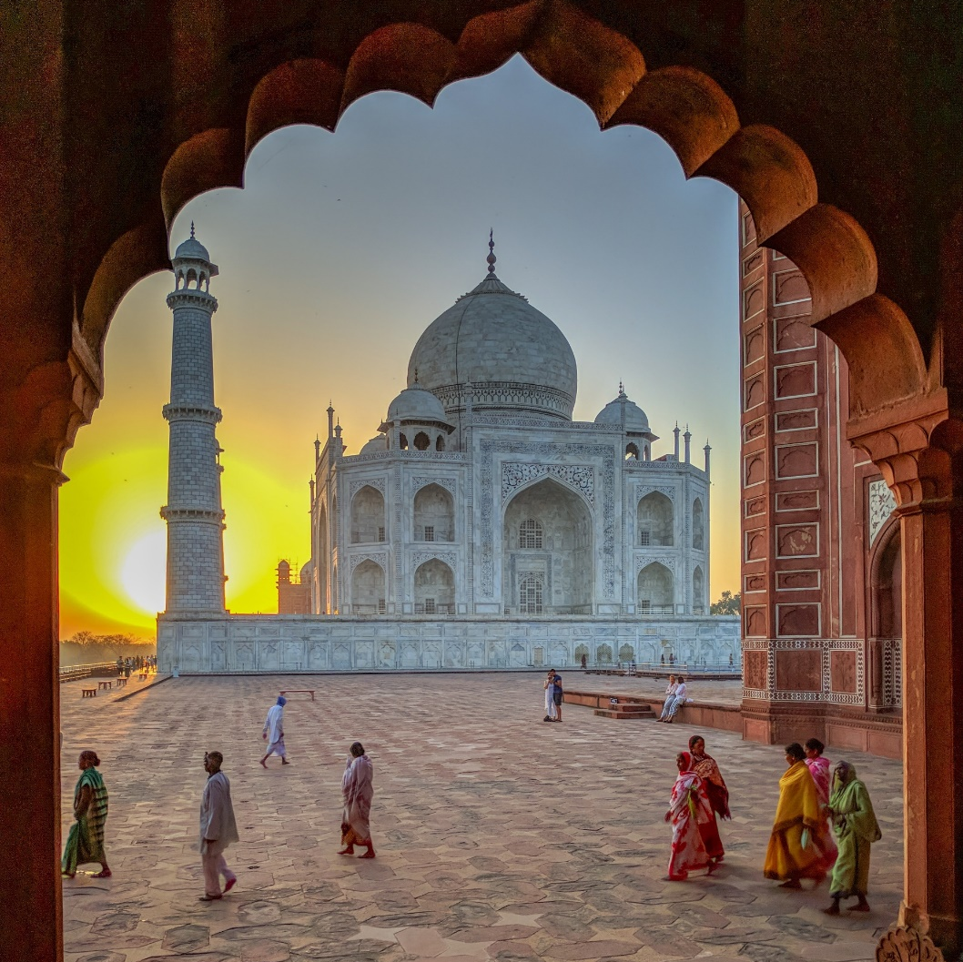
Surrounding the Taj Mahal
Either side of the main building are other buildings made from red sandstone as well as gates and fences that border the three sides of the complex.

Slide 6
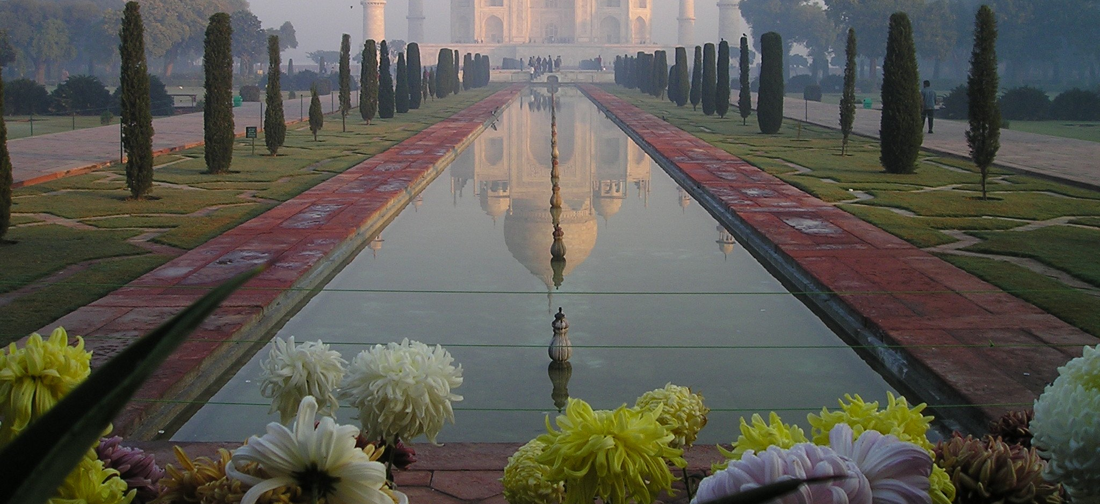
The Garden and Reflective Pool
The Taj Mahal’s design was influenced by Persian, Indian and Islamic cultures. The focus was on geometric patterns and symmetry, which the gardens and reflective pool demonstrate beautifully.

Slide 7
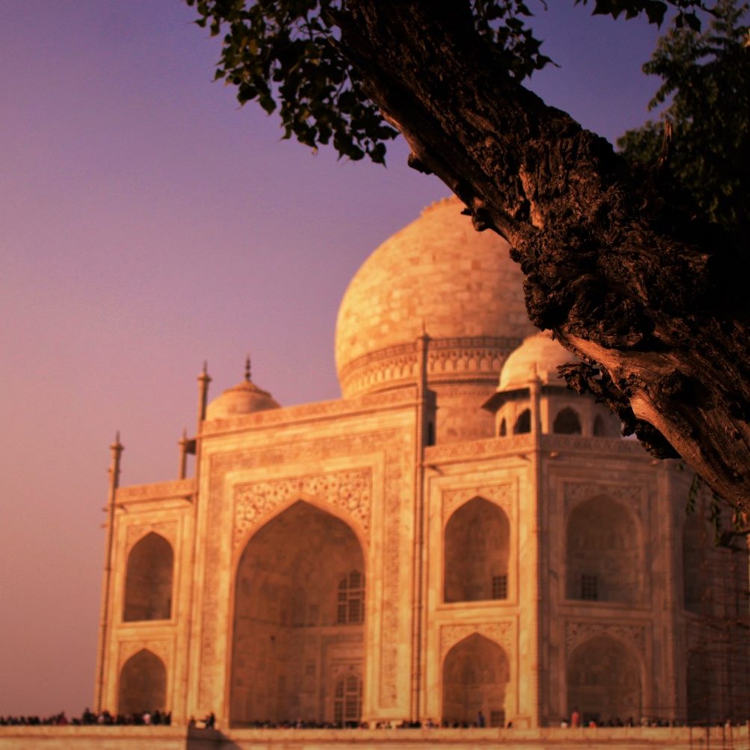
The Cost of the Taj Mahal
The Taj Mahal took 12 years, 20,000 workers and 1,000 elephants to build.
The estimated cost at the time it was built was 32 million rupees, which converts to over a trillion Australian dollars today.

Slide 8
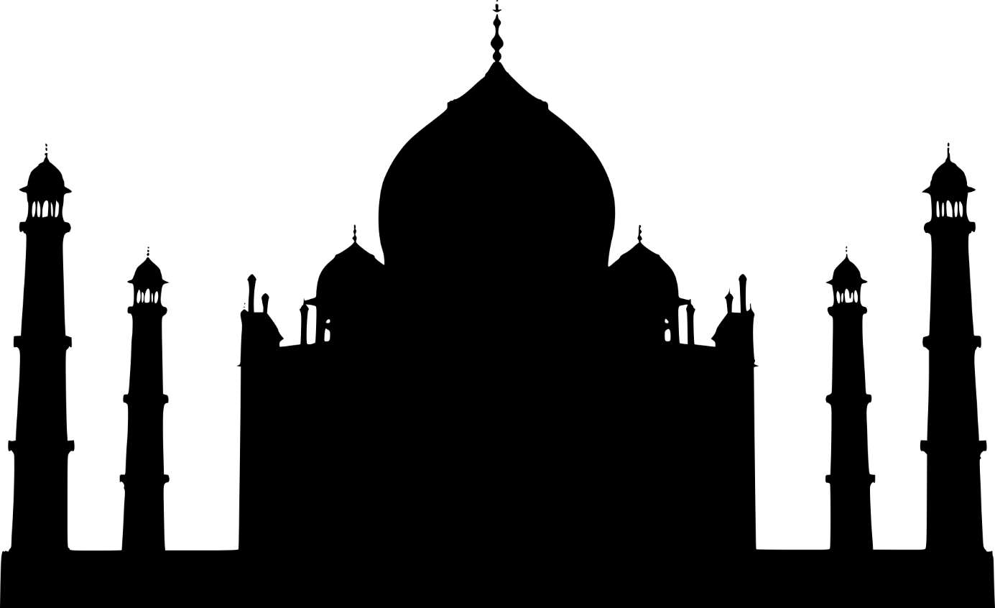
A Second Taj Mahal?
Shah Jahan announced plans for a second, black Taj Mahal to mirror the white one and house his remains when he died. As the first Taj Mahal had bankrupted his empire, the people revolted and he was arrested.

Slide 9
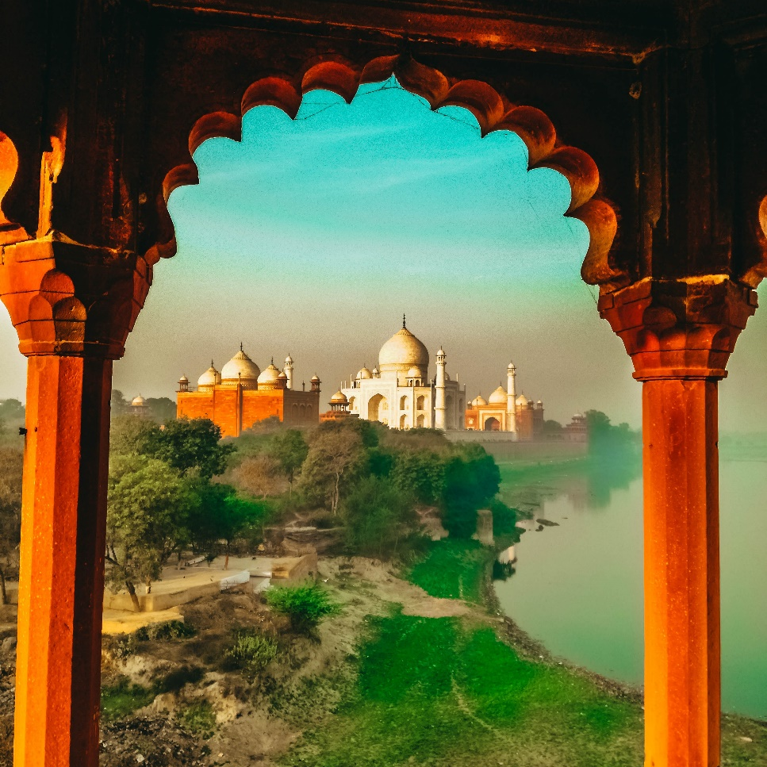
Shah Jahan
Shah Jahan spent the rest of his life in Agra’s Red Fort in a cell that looked out to the Taj Mahal, the building that got him into so much trouble. When he died he was buried beside Mumtaz under the Taj Mahal.

