Slide 2
The New Seven Wonders of the World
The ancient world had seven significant places, known as ‘The Seven Wonders of the World’. In 2000, a campaign was started to choose seven wonders of the modern world.
Over 100 million votes were cast. The final seven places chosen were:
Chichén Itzá, Mexico;
Machu Picchu, Peru;
Christ the Redeemer, Brazil;
The Colosseum, Italy;
Petra, Jordan;
Taj Mahal, India;
The Great Wall, China.
Today, we are going to find out about Christ the Redeemer in Brazil.

Slide 3
Where Is Brazil?
Brazil is in the continent of South America.

Slide 4
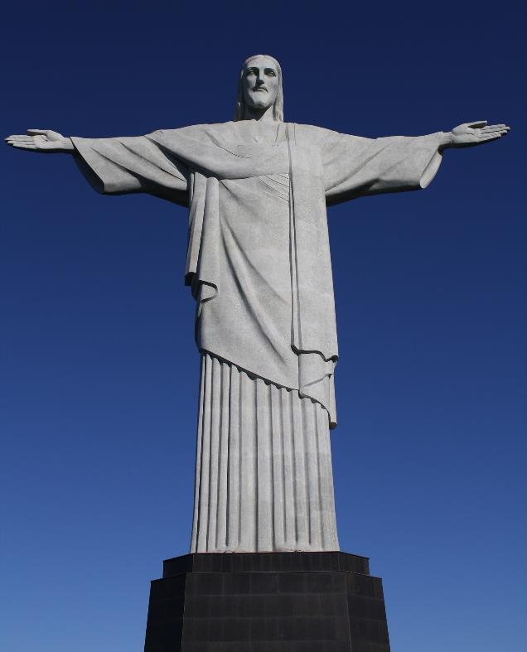
Christ the Redeemer
Christ the Redeemer is a statue on top of Corcovado mountain in Brazil. It overlooks the country’s largest city and former capital, Rio de Janeiro.
The statue shows Jesus Christ with his arms outstretched. Around 89% of Brazil’s population belong to the Christian faith.

Slide 5
Christ the Redeemer
Christ the Redeemer is 30 metres high (not including the statue base, which is 8 metres high). The arms of the statue are 28 metres wide. It weighs 635 tonnes.
It is only one-third of the height of the Statue of Liberty in the USA. However, as it sits on Corcovado mountain, which is around 700 metres high, Christ the Redeemer appears taller.

Slide 6
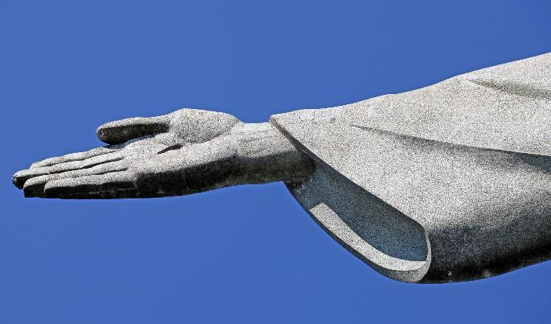
History of Christ the Redeemer
In 1920, a group of Brazilians started ‘Semana do Monumento’, which is Portuguese for ‘Monument Week’. The group campaigned for a religious statue to overlook Rio de Janeiro and collected donations to pay for it.
Different designs were made, including one of a cross and one of Jesus holding a globe. The winning design was created by Heitor da Silva Costa and the sculptor Paul Landowski.

Slide 7
History of Christ the Redeemer
Work on the statue started in 1922 and took nine years to complete. The inside of the structure was made from concrete reinforced with metal. The outside of the statue was made from soapstone. It cost the equivalent of £2.9m in today’s money.
The statue was built under Silva Costa's supervision, with the support of Albert Caquot from France.
The face of the statue was designed by Gheorghe Leonida from Romania.

Slide 8
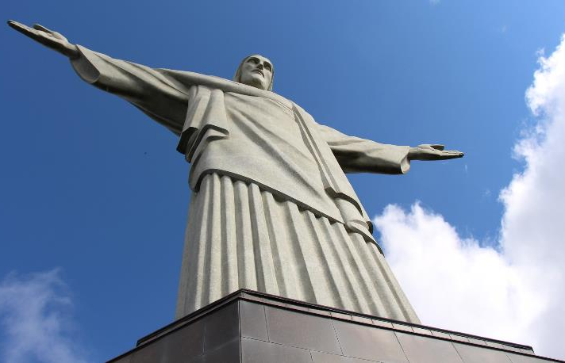
Christ the Redeemer
The statue has been struck by lightning and severely damaged several times. In 2008, the fingers, head and eyebrows of the statue were badly damaged. In 2014, another thunderstorm caused one of the statue’s fingers to fall off.
In 2010, a major programme of restoration was started on the statue, that included making it more waterproof.
The statue needs regular maintenance. The original soapstone is no longer available so modern additions are in slightly darker stone.

Slide 9
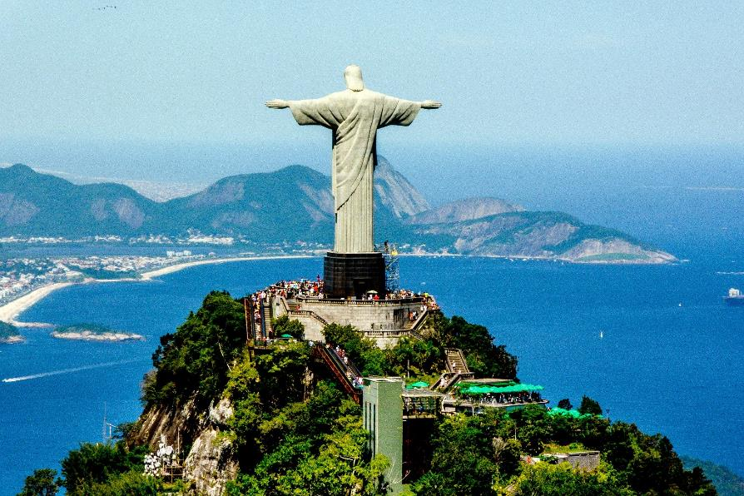
Christ the Redeemer
In 2003, escalators and walkways were built to make it easier to reach the statue. Over 1m tourists visit the statue each year. At Easter in 2011, the statue received a record number of visitors in one day, with 14,000 tourists making the trip up Corcovado mountain.

Slide 10
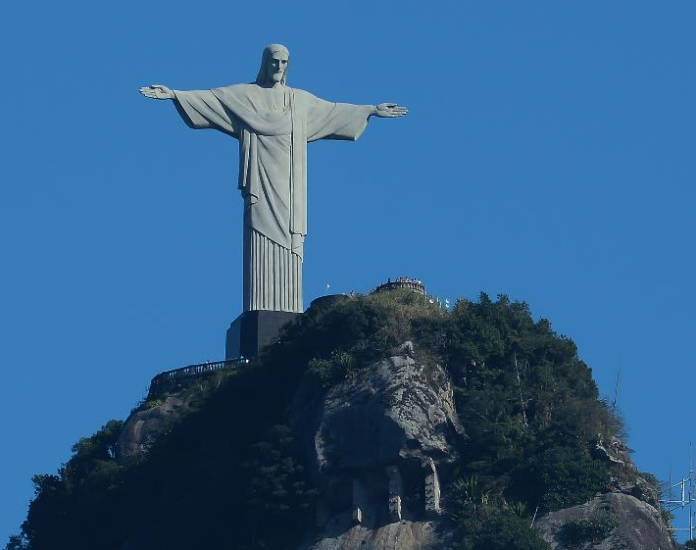
Christ the Redeemer
October 2006 was the 75th anniversary of the completion of the statue. To mark the anniversary, a chapel was made in the hollow base of the statue. After special prayers and blessings from a priest, the chapel was opened to be used for baptisms and weddings.
In 2010, the statue was lit in green and yellow in support of Brazil’s football team playing in the football World Cup.

