Slide 2
The New Seven Wonders of the World
The ancient world had seven significant places, known as ‘The Seven Wonders of the World’. In 2000, a campaign began to choose seven wonders of the modern world.
Over 100 million votes were cast. The final seven places chosen were:
Chichén Itzá, Mexico;
Machu Picchu, Peru;
Christ the Redeemer, Brazil;
The Colosseum, Italy;
Petra, Jordan;
Taj Mahal, India;
The Great Wall, China.
Today, we are going to find out about the Great Wall of China.

Slide 3
Where Is China?
China is in the continent of Asia.

Slide 4
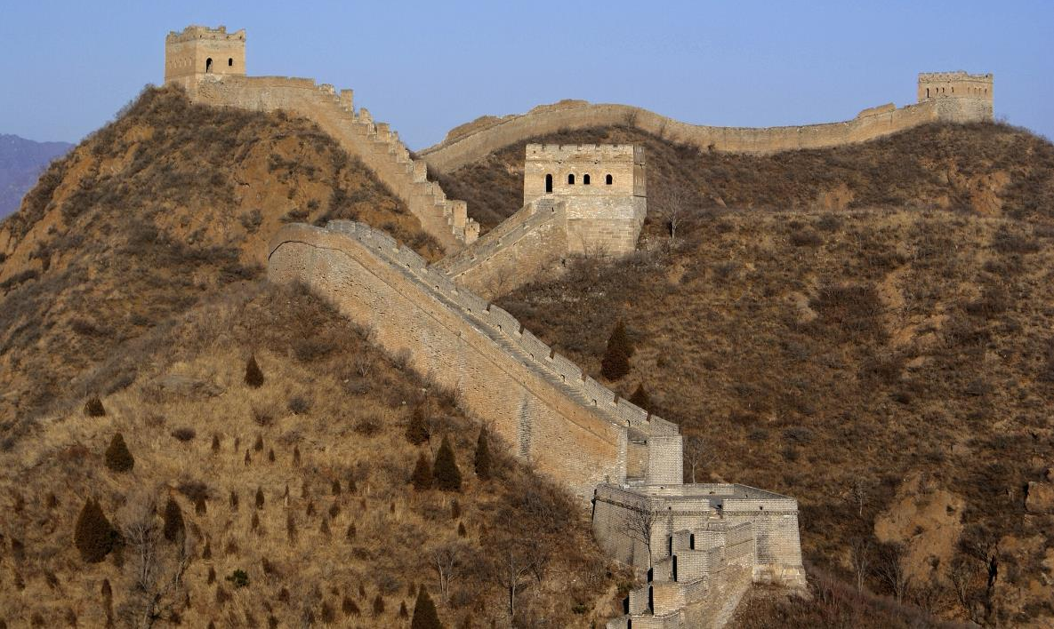
The Great Wall of China
The Great Wall of China is the longest wall in the world, measuring 21,196 km in length.

Slide 5
Where Is the Great Wall?
The Great Wall runs from east to west of northern China, near the border of Mongolia.

Slide 6
When Was the Great Wall First Built?
China was once a collection of states ruled separately. In 221 BC, Qin Shi Huang became the first Emperor of a unified China, having conquered all of the states. This was the start of the Qin dynasty (China used to be ruled by different family groups, known as dynasties).
Around 220 BC, Emperor Qin Shi Huang ordered for defences between the old states to be removed. He then set in action a plan to join together existing walls along the northern border to form a single defensive system. This would protect China from invasions from other countries.
The wall was known as the Wanli Changcheng, which means ‘10,000 Li-Long Wall’ - a li is a traditional Chinese measurement, which is about one third of a mile.
When built, the wall itself was between 5 and 9 metres high, with ramparts on top reaching around 3.5 metres higher. Beacons or guard towers were spaced along the structure.

Slide 7
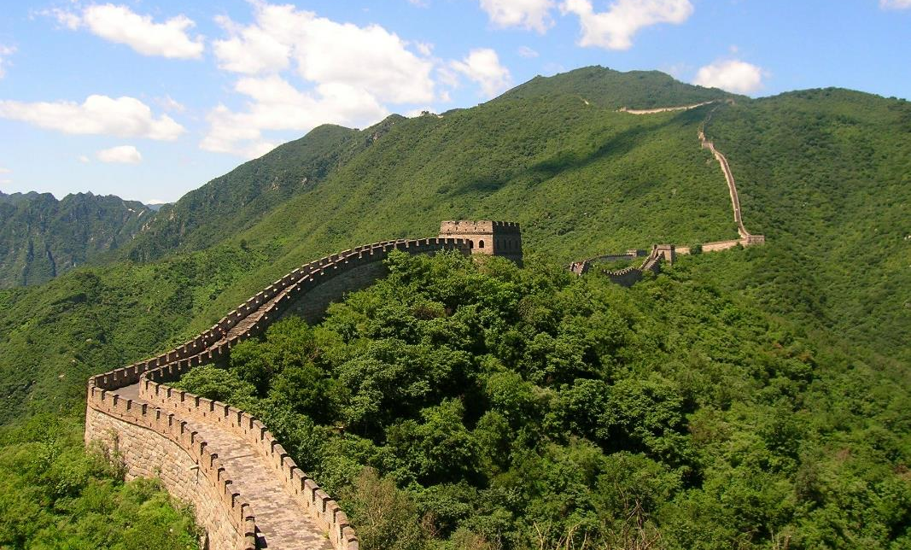
How Was the Great Wall Built?
The wall was largely built by soldiers and convicts. It is thought that around 1 million tonnes of stone, bricks and soil were used to build the wall. The materials were carried either by hand or on animals. Historians estimate that around 400,000 people died during the construction of the wall.

Slide 8
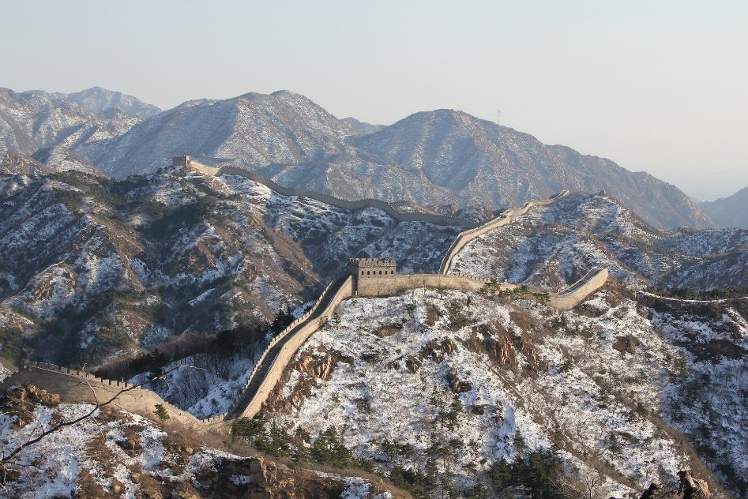
Rebuilding
The Qin dynasty collapsed in around 206 BC and the wall fell into disrepair. Some dynasties that followed fixed different parts of the wall but the most significant changes occurred during the reign of the Ming dynasty, which shaped the wall into what we see today.
During the Ming dynasty, Beijing was declared the capital city of China and there was a lot of construction. The wall was carefully maintained and strengthened to prevent invasions from other countries.

Slide 9
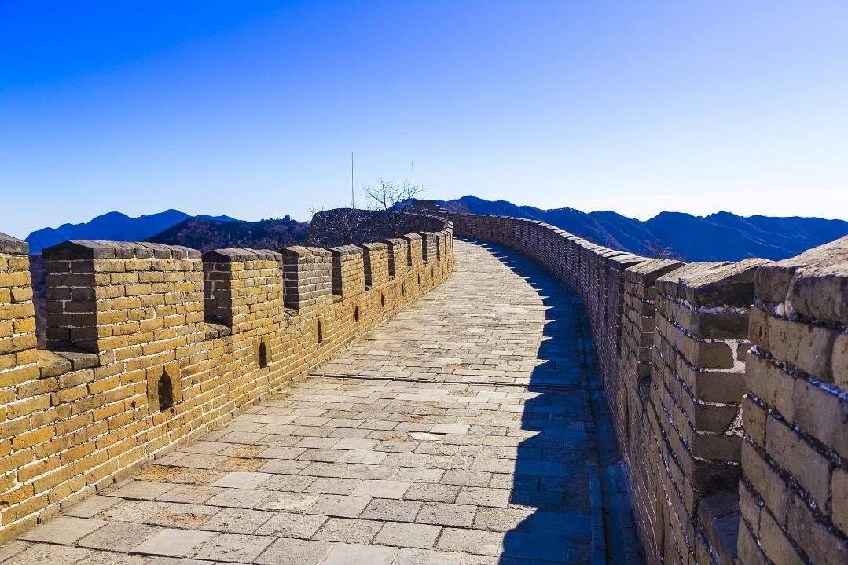
The Great Wall Today
Today, not all of the wall looks like the picture below and lots of it isn’t actually a wall anymore. There are mounds of earth that show where the route of the wall once was. Only sections of the wall are as well-preserved as shown in the photo, particularly around Beijing.

Slide 10
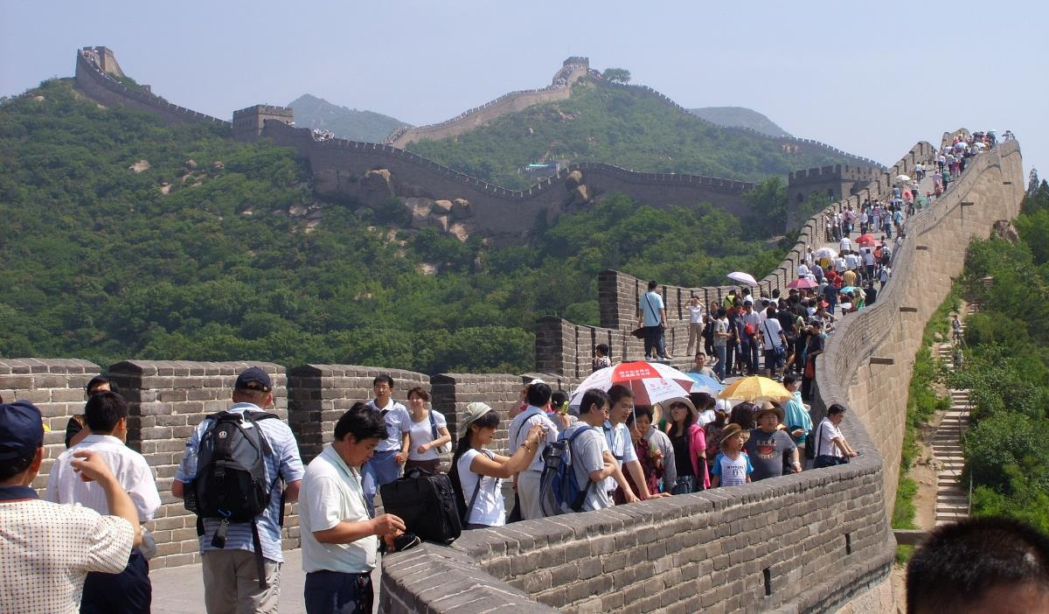
The Great Wall Today
The Great Wall of China is a popular tourist attraction. Each year, hundreds of thousands of visitors participate in walking holidays, where tourists trek along sections of the wall.

