Slide 1
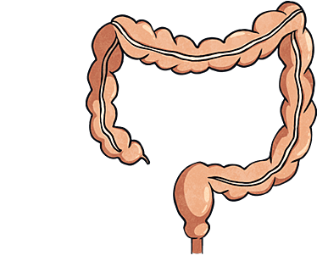
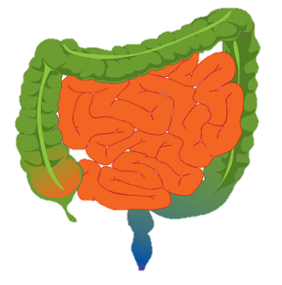
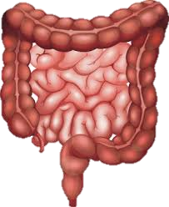
Large Intestines
By Ethan

Slide 2
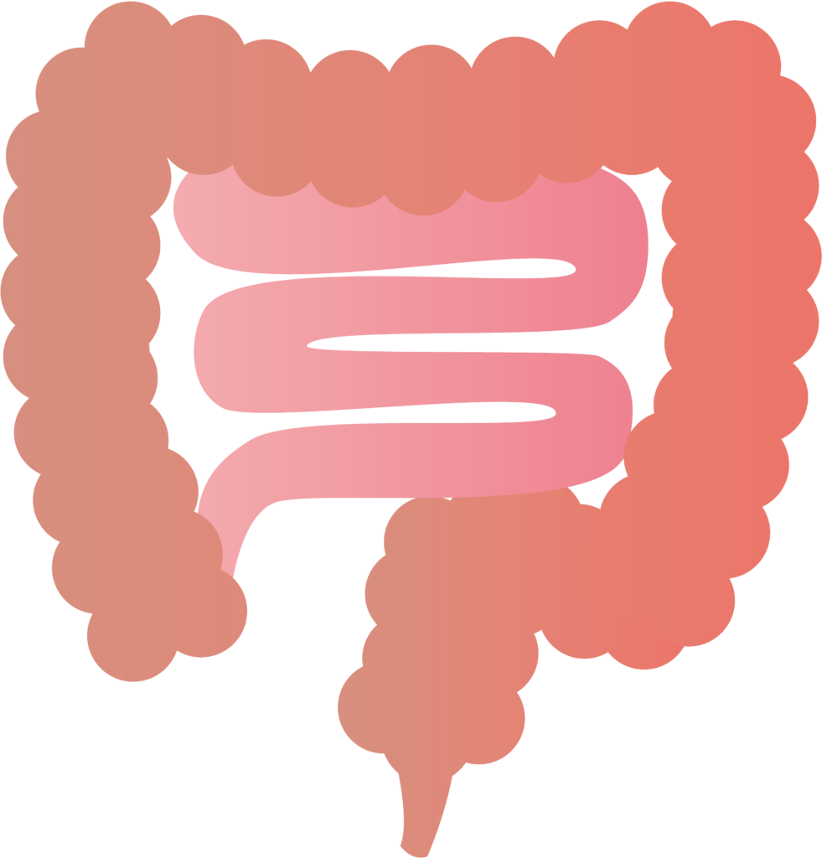
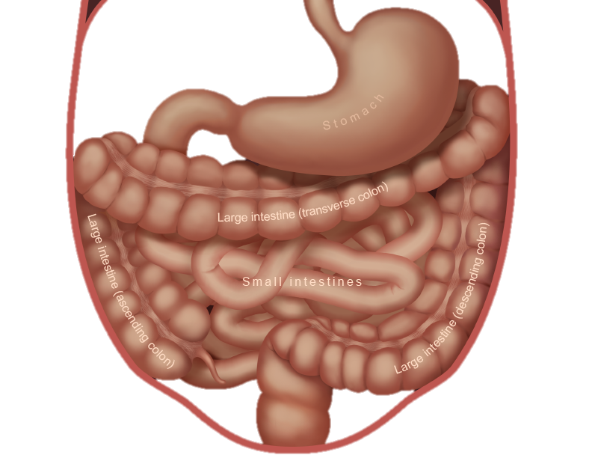
What does the large intestine do?
The large intestines absorbs water and changes the waste from liquid into stool.

Slide 3
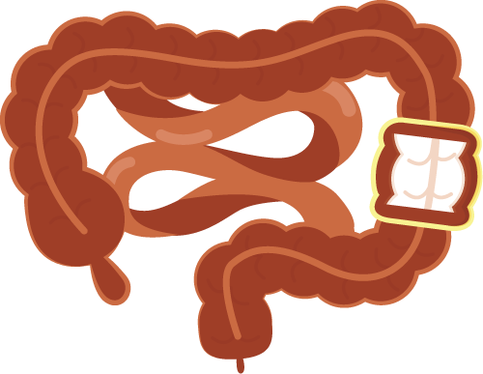
Where is the large intestine located?
Your large intestine is found in your abdomen.

Slide 4
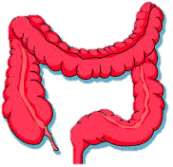
What does the large intestine look like?
The large intestine looks like and upside down ‘U.’

Slide 5
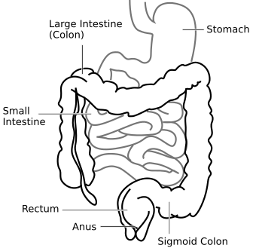
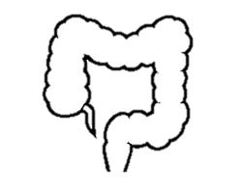
Are there any specific parts of the large intestine?
The large intestine consists of the colon, rectum and the anal canal.

Slide 6
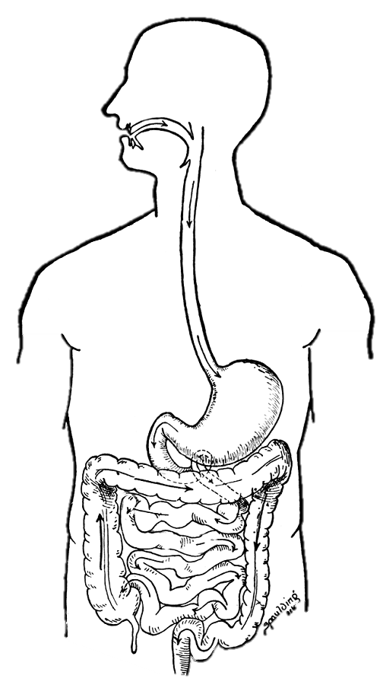
What system does the large intestine belong to?
The large intestine belongs to the Digestive System.
Large Intestine

Slide 7
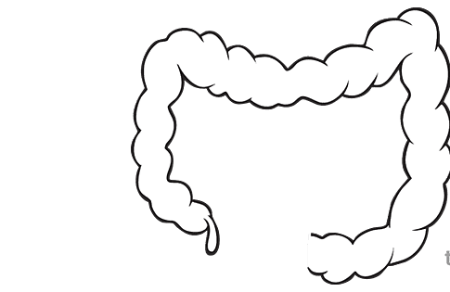
Interesting facts about the large intestine.
The large intestine is about five feet long and three inches wide.
You have detergents in your large intestine.
Over 400 species of bacteria in our large intestine.
The large intestine can turn food material into poop
It takes about eight to ten hours from the time the food material enters the large intestine until it is excreted as waste.

