Slide 1
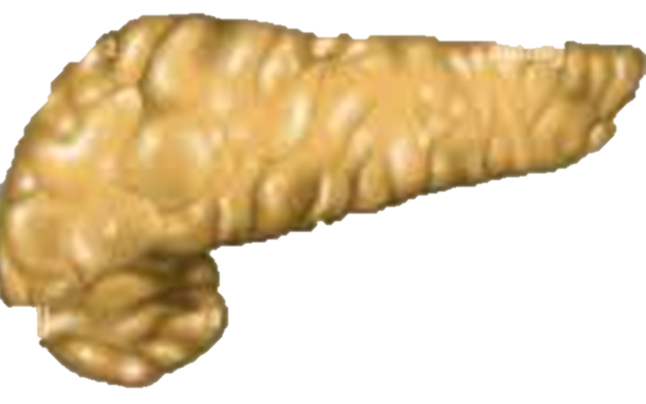
The Pancreas
By Aaron and Jenson

Slide 2
What does the Pancreas do?
The pancreas produces strong enzymes that are important for digestion.

Slide 3
Where would you find the pancreas?
The pancreas sits behind your stomach in your belly.

Slide 4
What does the Pancreas look like?
The pancreas is a long, flat gland in your belly.

Slide 5
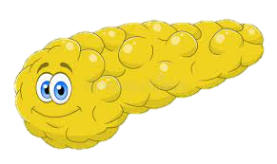
Are there any specific parts of the Pancreas?
A specific part of the Pancreas is the Islets of Langerhans.

Slide 6
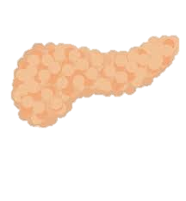
What system does the Pancreas belong to?
The pancreas is part of the Digestive System as well as the Endocrine System.

Slide 7
Interesting facts on the Pancreas?
It is about 6 inches long and 2 inches wide.
It is really 2 separate glands inside the same organ.

