Slide 1
The Heart
By Megan and Jacinda

Slide 2
What does the heart do?
The heart sends blood around the body so you can live.

Slide 3
Where is the heart located?
The heart is located a little to the left of the middle of your chest.

Slide 4
What does the heart look like?
Your heart is sort of like a pump or two pumps in one.

Slide 5
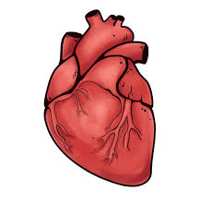
Are there any specific parts of the heart?
The heart has a left atrium and a right atrium.

Slide 6
What system does the heart belong to?
The system the heart belongs to is the circulatory system.

Slide 7
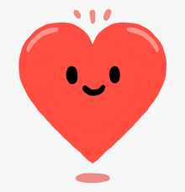
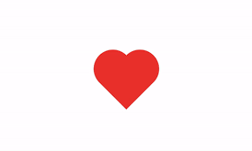
Interesting facts on the heart.
The average size of a heart is the size of a adult fist.
Your heart will beat about 115,000 times each day.
Each day your heart pumps about 2,000 gallons of blood around the body.

