Slide 1
The Wonderful Christmas
By Aaron , Aimee and Lucinda.

Slide 2
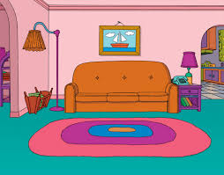
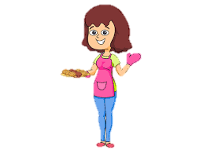
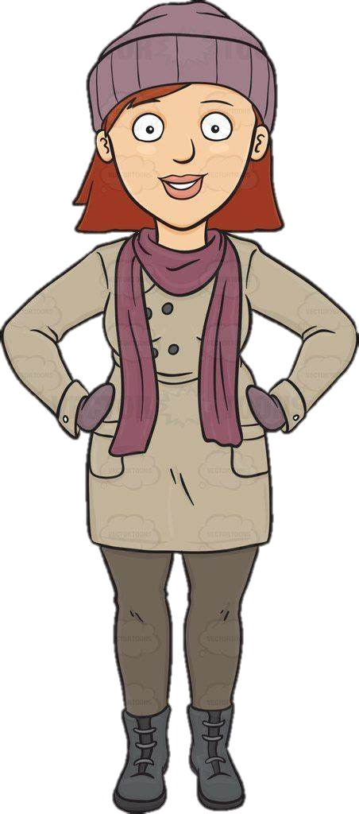
One cold Christmas Eve, Ella and Rosie were in the living room.

Slide 3
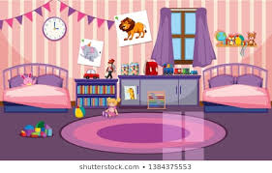
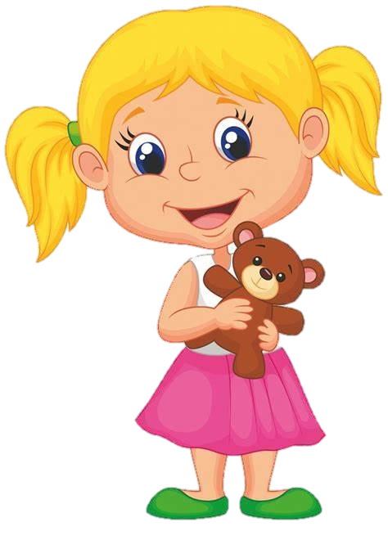
Mum said to get ready for bed as tomorrow was Christmas Day.

Slide 4
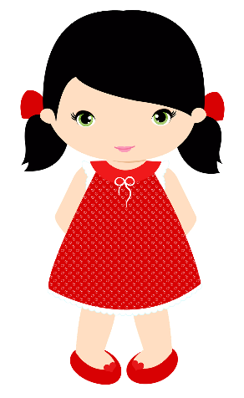
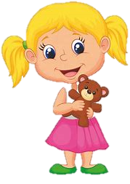
They went to bed and fell asleep straight away.

Slide 5
During the night they heard a thump on the roof.

Slide 6
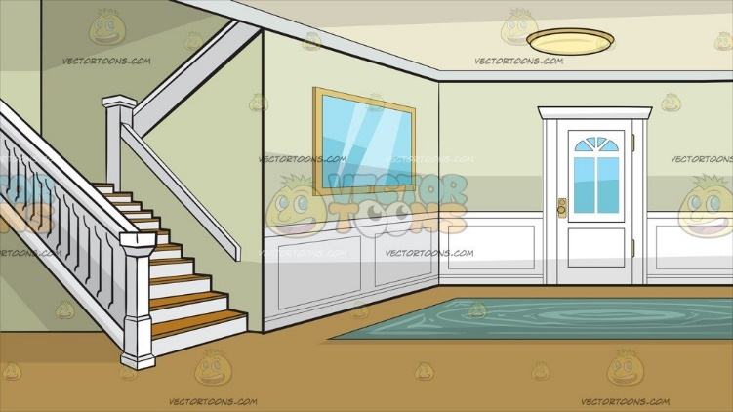
Both children came down stairs and saw Santa.

Slide 7
Santa offered to take them to the workshop.
Yes please
Yeah
Do you want to come to my workshop

Slide 8
They had to go in the sleigh to get there so they ran outside and jumped into the sleigh.

Slide 9
The children and Santa flew up into the sky.

Slide 10
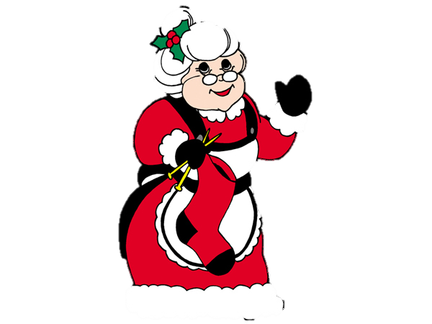
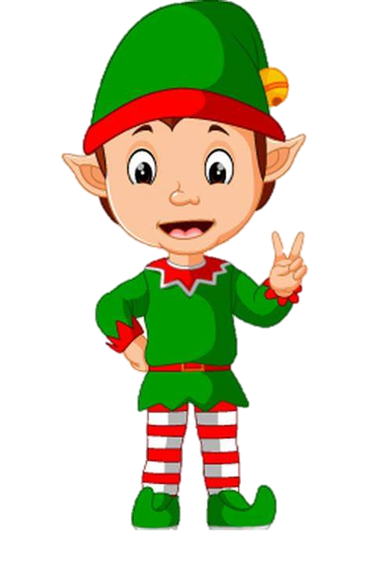
When they arrived at the workshop at the North Pole they saw a nice elf and Mrs Claus.
This is my best elf and my wife Mrs clause
Well hello there little ones
Nice to meet you
thankyou
hi

Slide 11
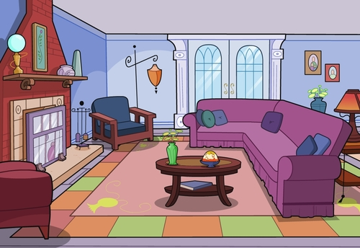
Mrs Claus offered them milk and cookies and they all had a party.

Slide 12
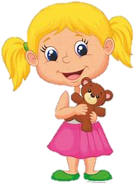
Then Santa took them home in the sleigh and they went to bed.

Slide 13
The next morning, they woke up and opened their presents and played with them all day long.

Slide 14
THE END
Hope you enjoyed the story make sure you have a wonderful Christmas.
HAPPY CHRISTMAS.

