Slide 1
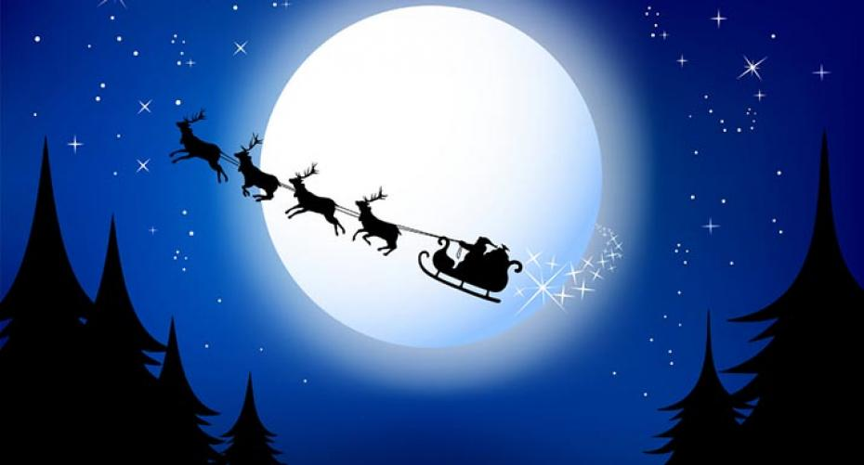
By Daisy-lee and Noah.
Our Journey with Santa

Slide 2
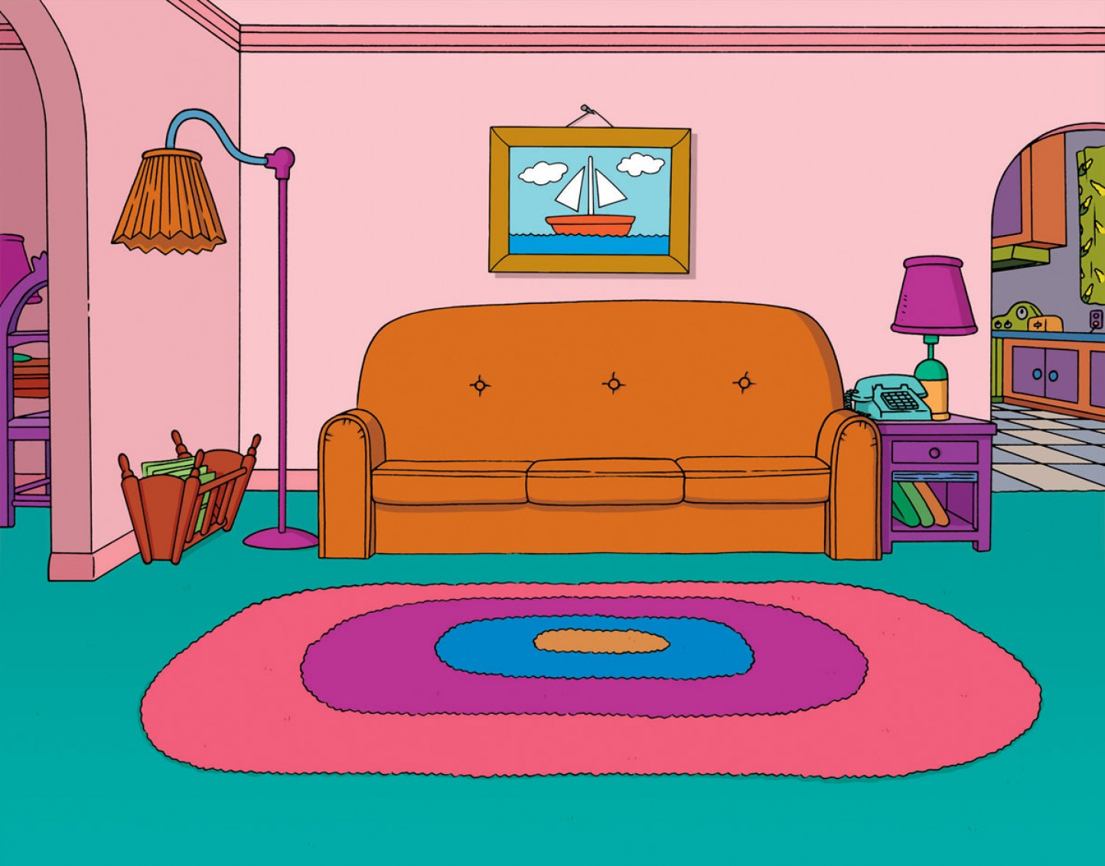
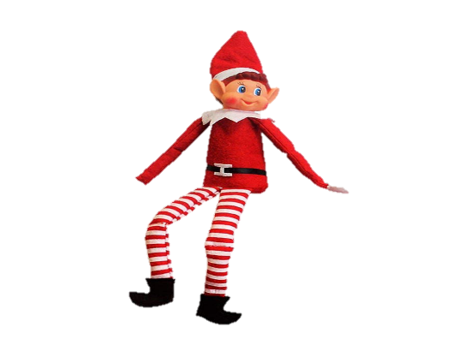
One snowy Christmas Eve, Adam and Emily were getting ready for Santa's arrival.

Slide 3
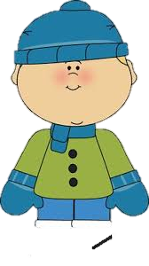
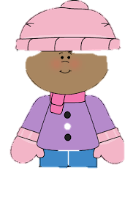
After Adam and Emily got ready for Santa's arrival they went to bed.

Slide 4
Suddenly, at 1 o'clock in the morning they heard a noise on the roof so they went outside and they saw Santa on the roof.

Slide 5
They got a ladder from the garage and put it onto the snowy roof. Adam and Emily climbed up the ladder onto the snowy roof to speak to Santa.

Slide 6
Santa was so kind that he took Adam and Emily for a ride around the world to help him deliver presents.

Slide 7
They visited England, France, Brazil, Northern Ireland, Germany and Scotland.

Slide 8
After they went to all the countries delivering presents, Santa took them back home.

Slide 9
Then they rushed back to bed before their parents woke up.

Slide 10
The next morning Adam and Emily woke their parents by jumping on their bed.

Slide 11
Their parents woke up and they all rushed downstairs to open their presents.

Slide 12
They opened their presents and Adam got an X Box One and Emily got a Barbie.

Slide 13
After they opened their presents they played with them all day long.

