Slide 1
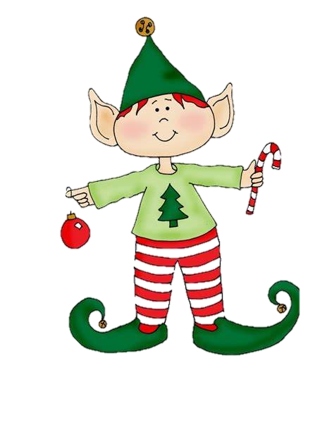
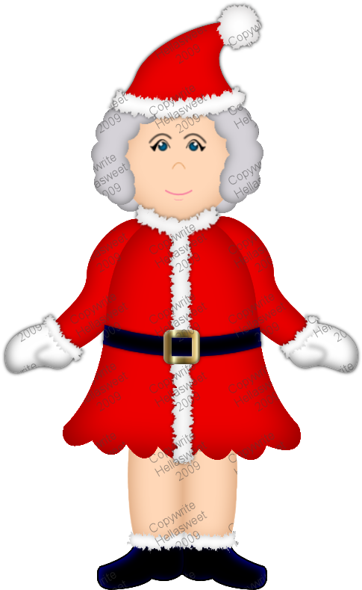
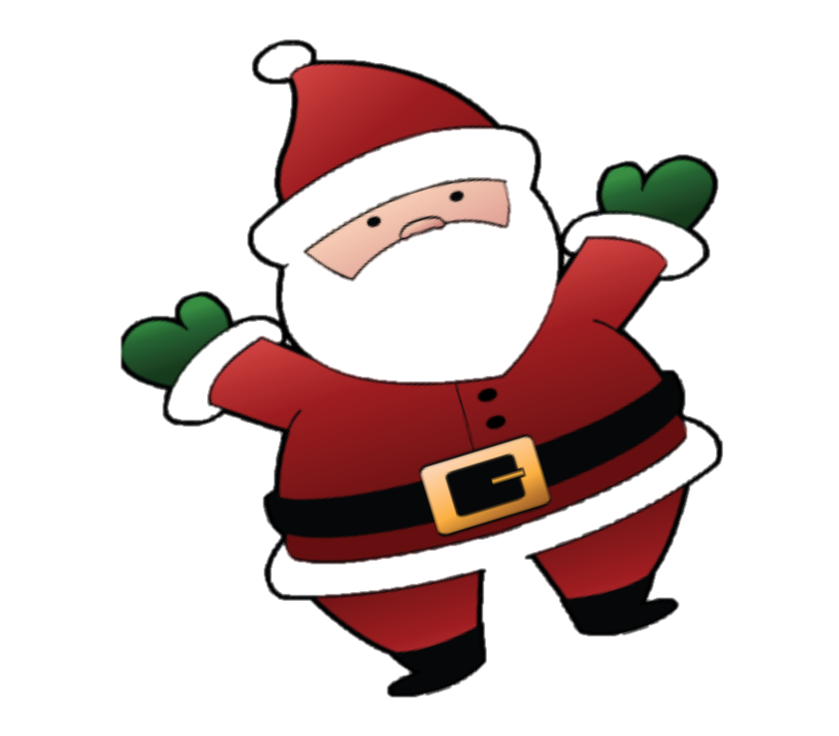
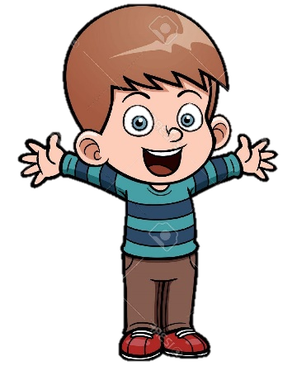
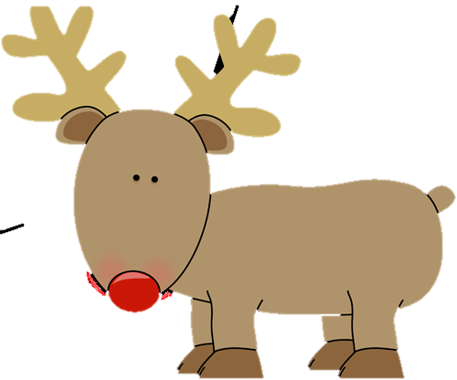
Jimmy's Adventure

Slide 2
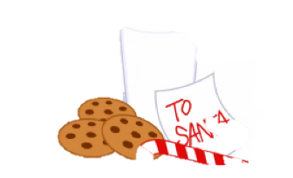
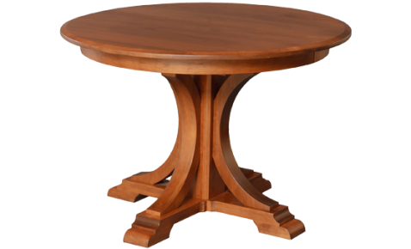
One cold Christmas Eve, Jimmy was in the living room setting the milk and cookies on the table.

Slide 3
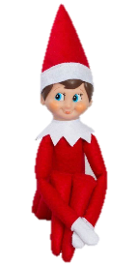
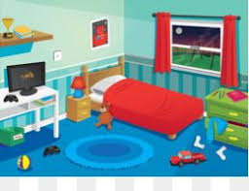
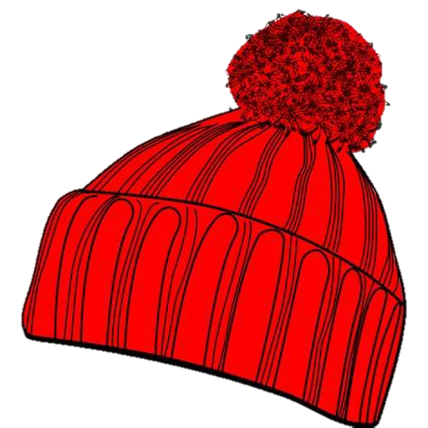
After Jimmy brushed his teeth, he went into his bedroom to get into bed.

Slide 4
When Jimmy was sleeping he woke to a thump on the roof, so he got out of bed to see what it was.

Slide 5
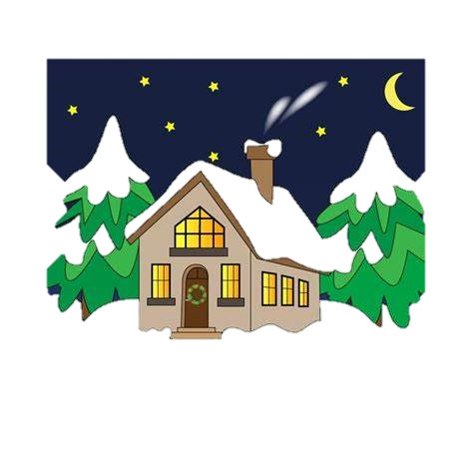
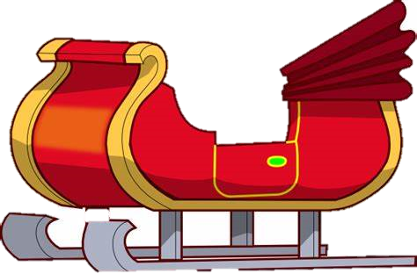
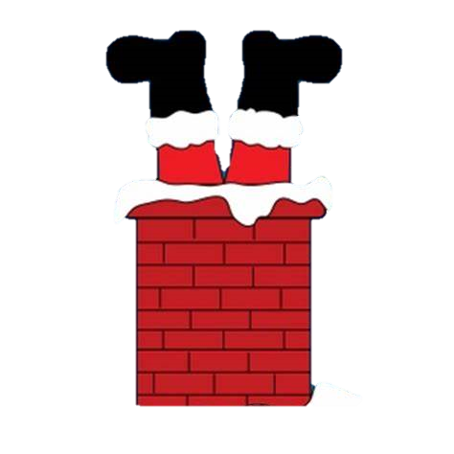
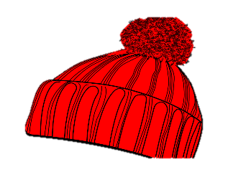
Jimmy went outside and looked up at the roof and saw that saw that Santa was stuck in the chimney.

Slide 6
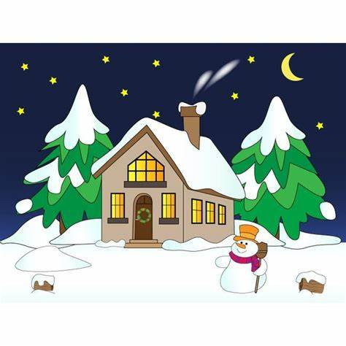
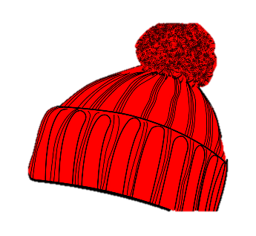
Jimmy got a rope and tied it to Santa’s foot and tried to pull him out but it didn't work.

Slide 7
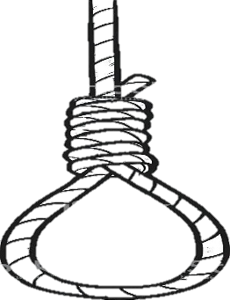
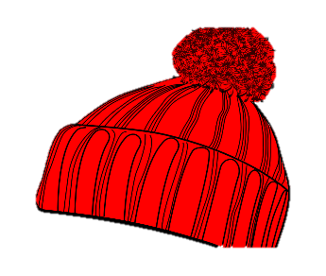
So then he tied the rope onto Rudolph, and finally he pulled Santa out.

Slide 8
Santa thanked Jimmy by offering him a trip around the world and to go to the North Pole.

Slide 9
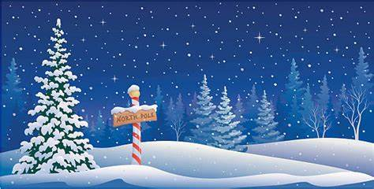
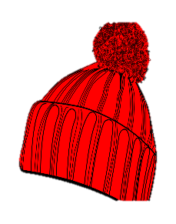
Santa and Jimmy got in the sleigh and they took off and landed safely at the North Pole

Slide 10
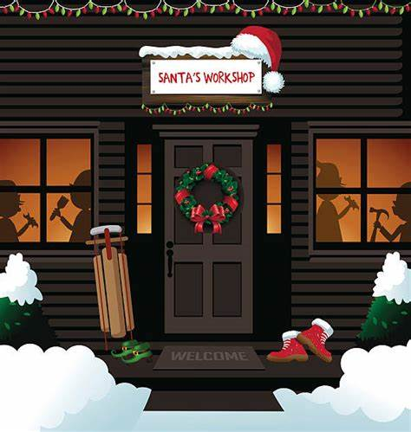
Once they landed Mrs. Claus came out to meet Jimmy and took him into the workshop.

Slide 11
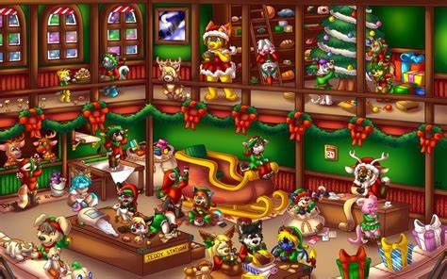
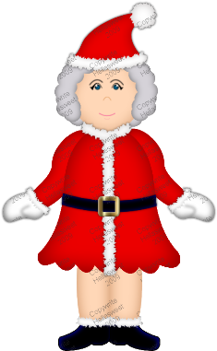
Once Jimmy went into the workshop an Elf came and welcomed Jimmy, and took him a tour around the workshop.

Slide 12
After the tour, Jimmy helped the Elf to line up the Reindeer ready to take off again.

Slide 13
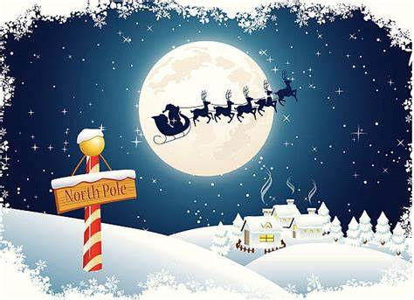
Then Santa and Jimmy took off back to Jimmy's house so he could get back in bed for Chirstmas morning.

Slide 14
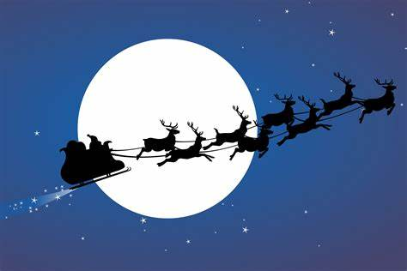
Santa went to deliver the rest of the presents and left Jimmy a lovely surprise and a note

